Slide 1
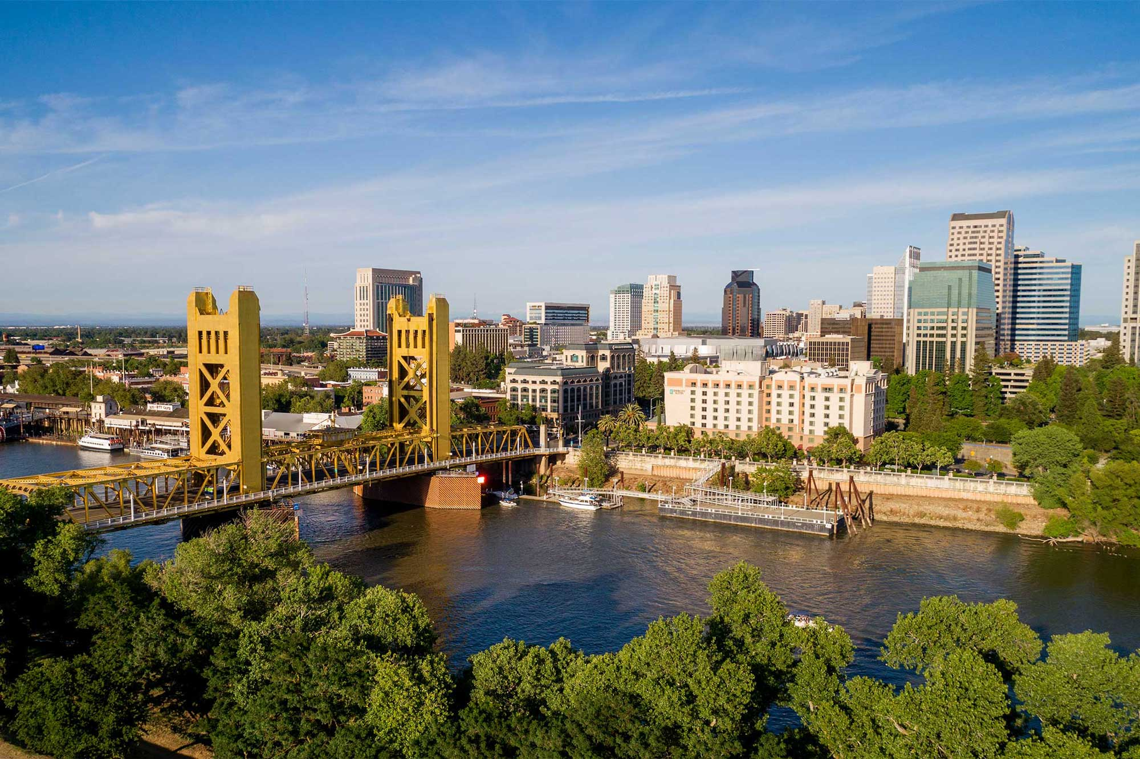
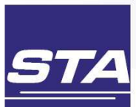
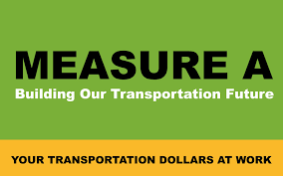
Sacramento County Measure A Funds
Impact on SacRT Services and Programs
Presentation to ITOC
May 22, 2025

Slide 2
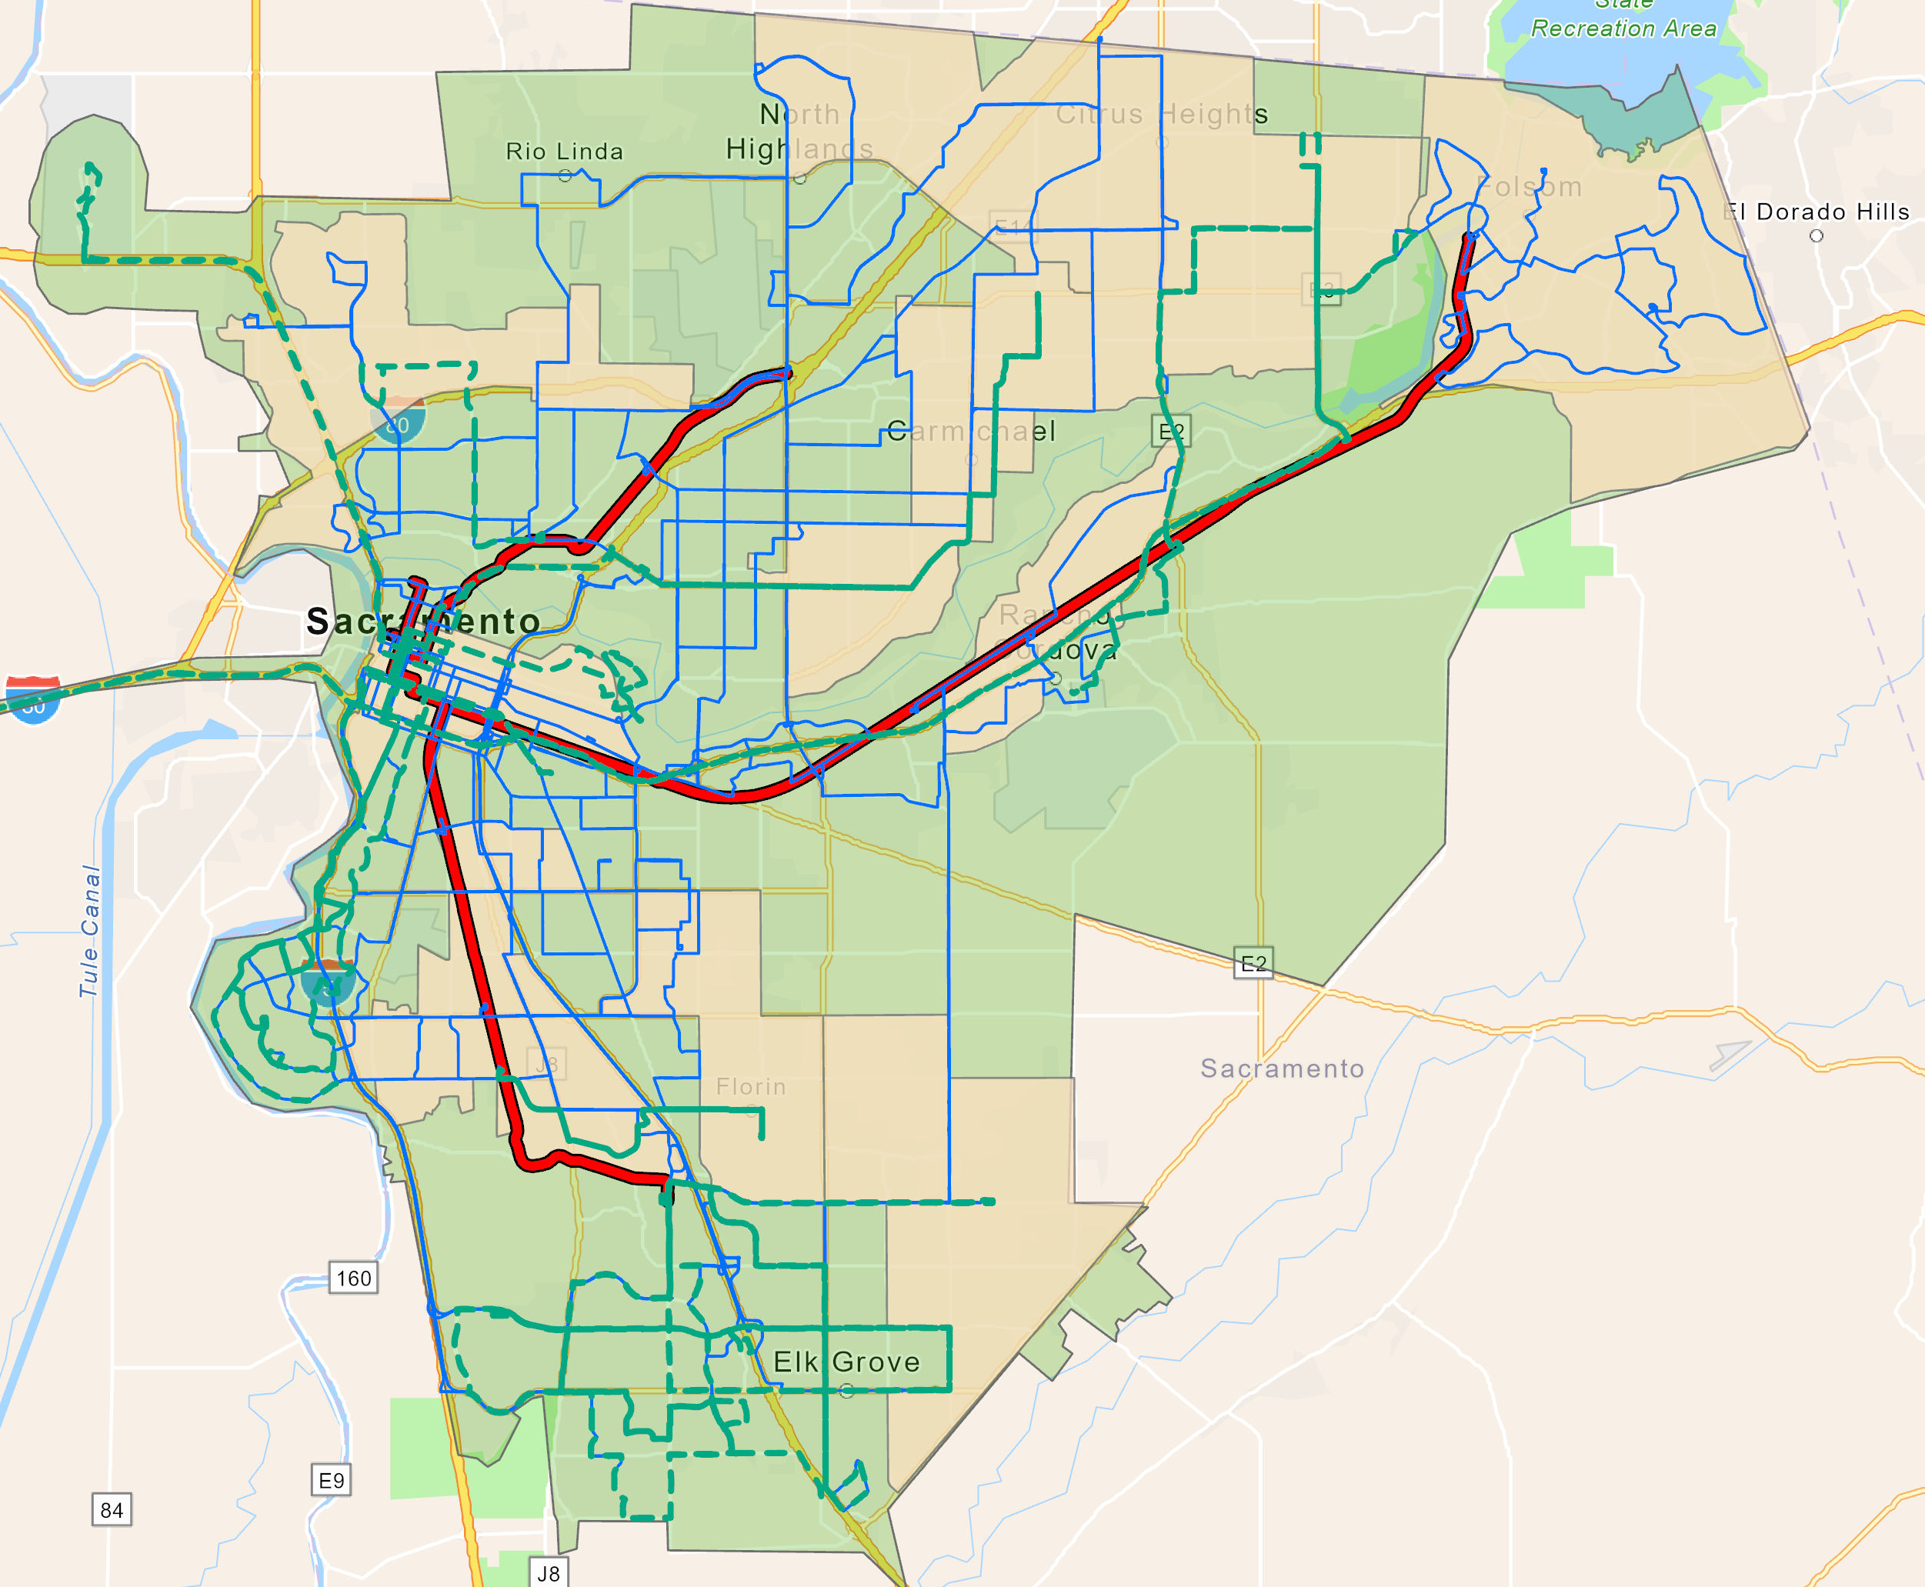
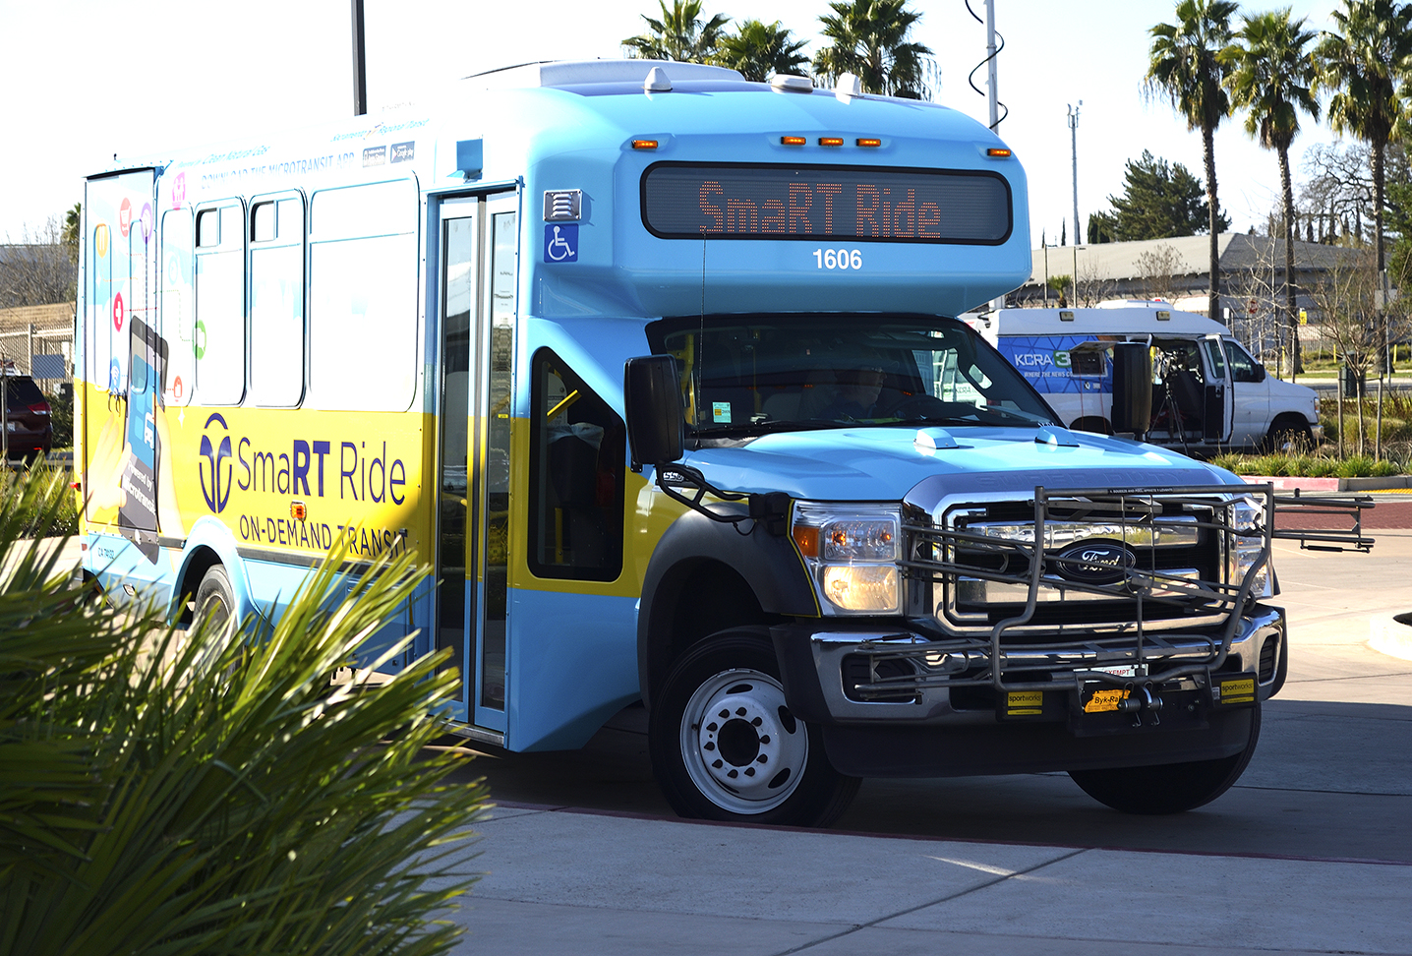
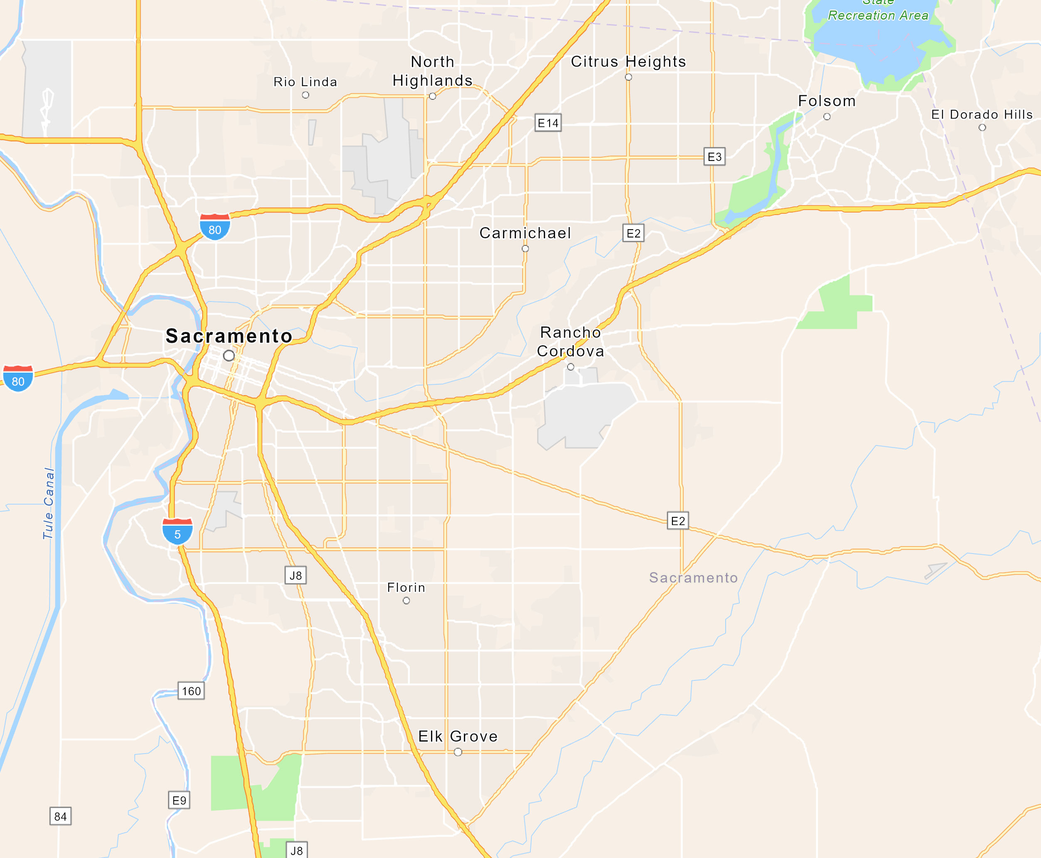
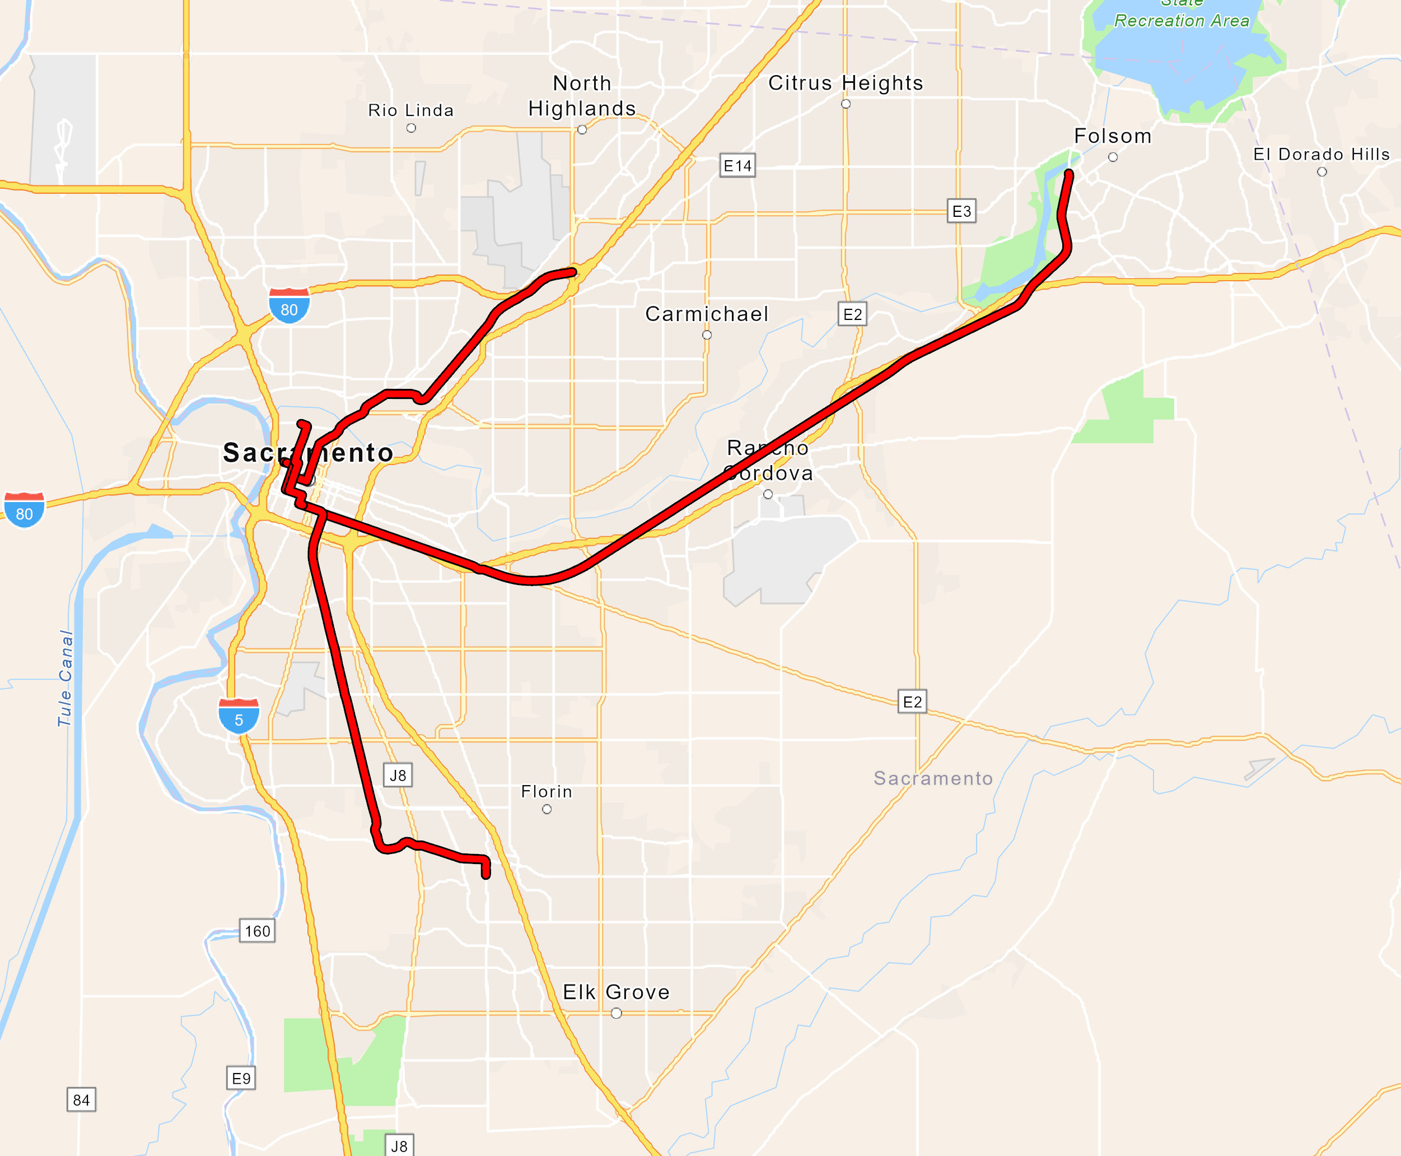
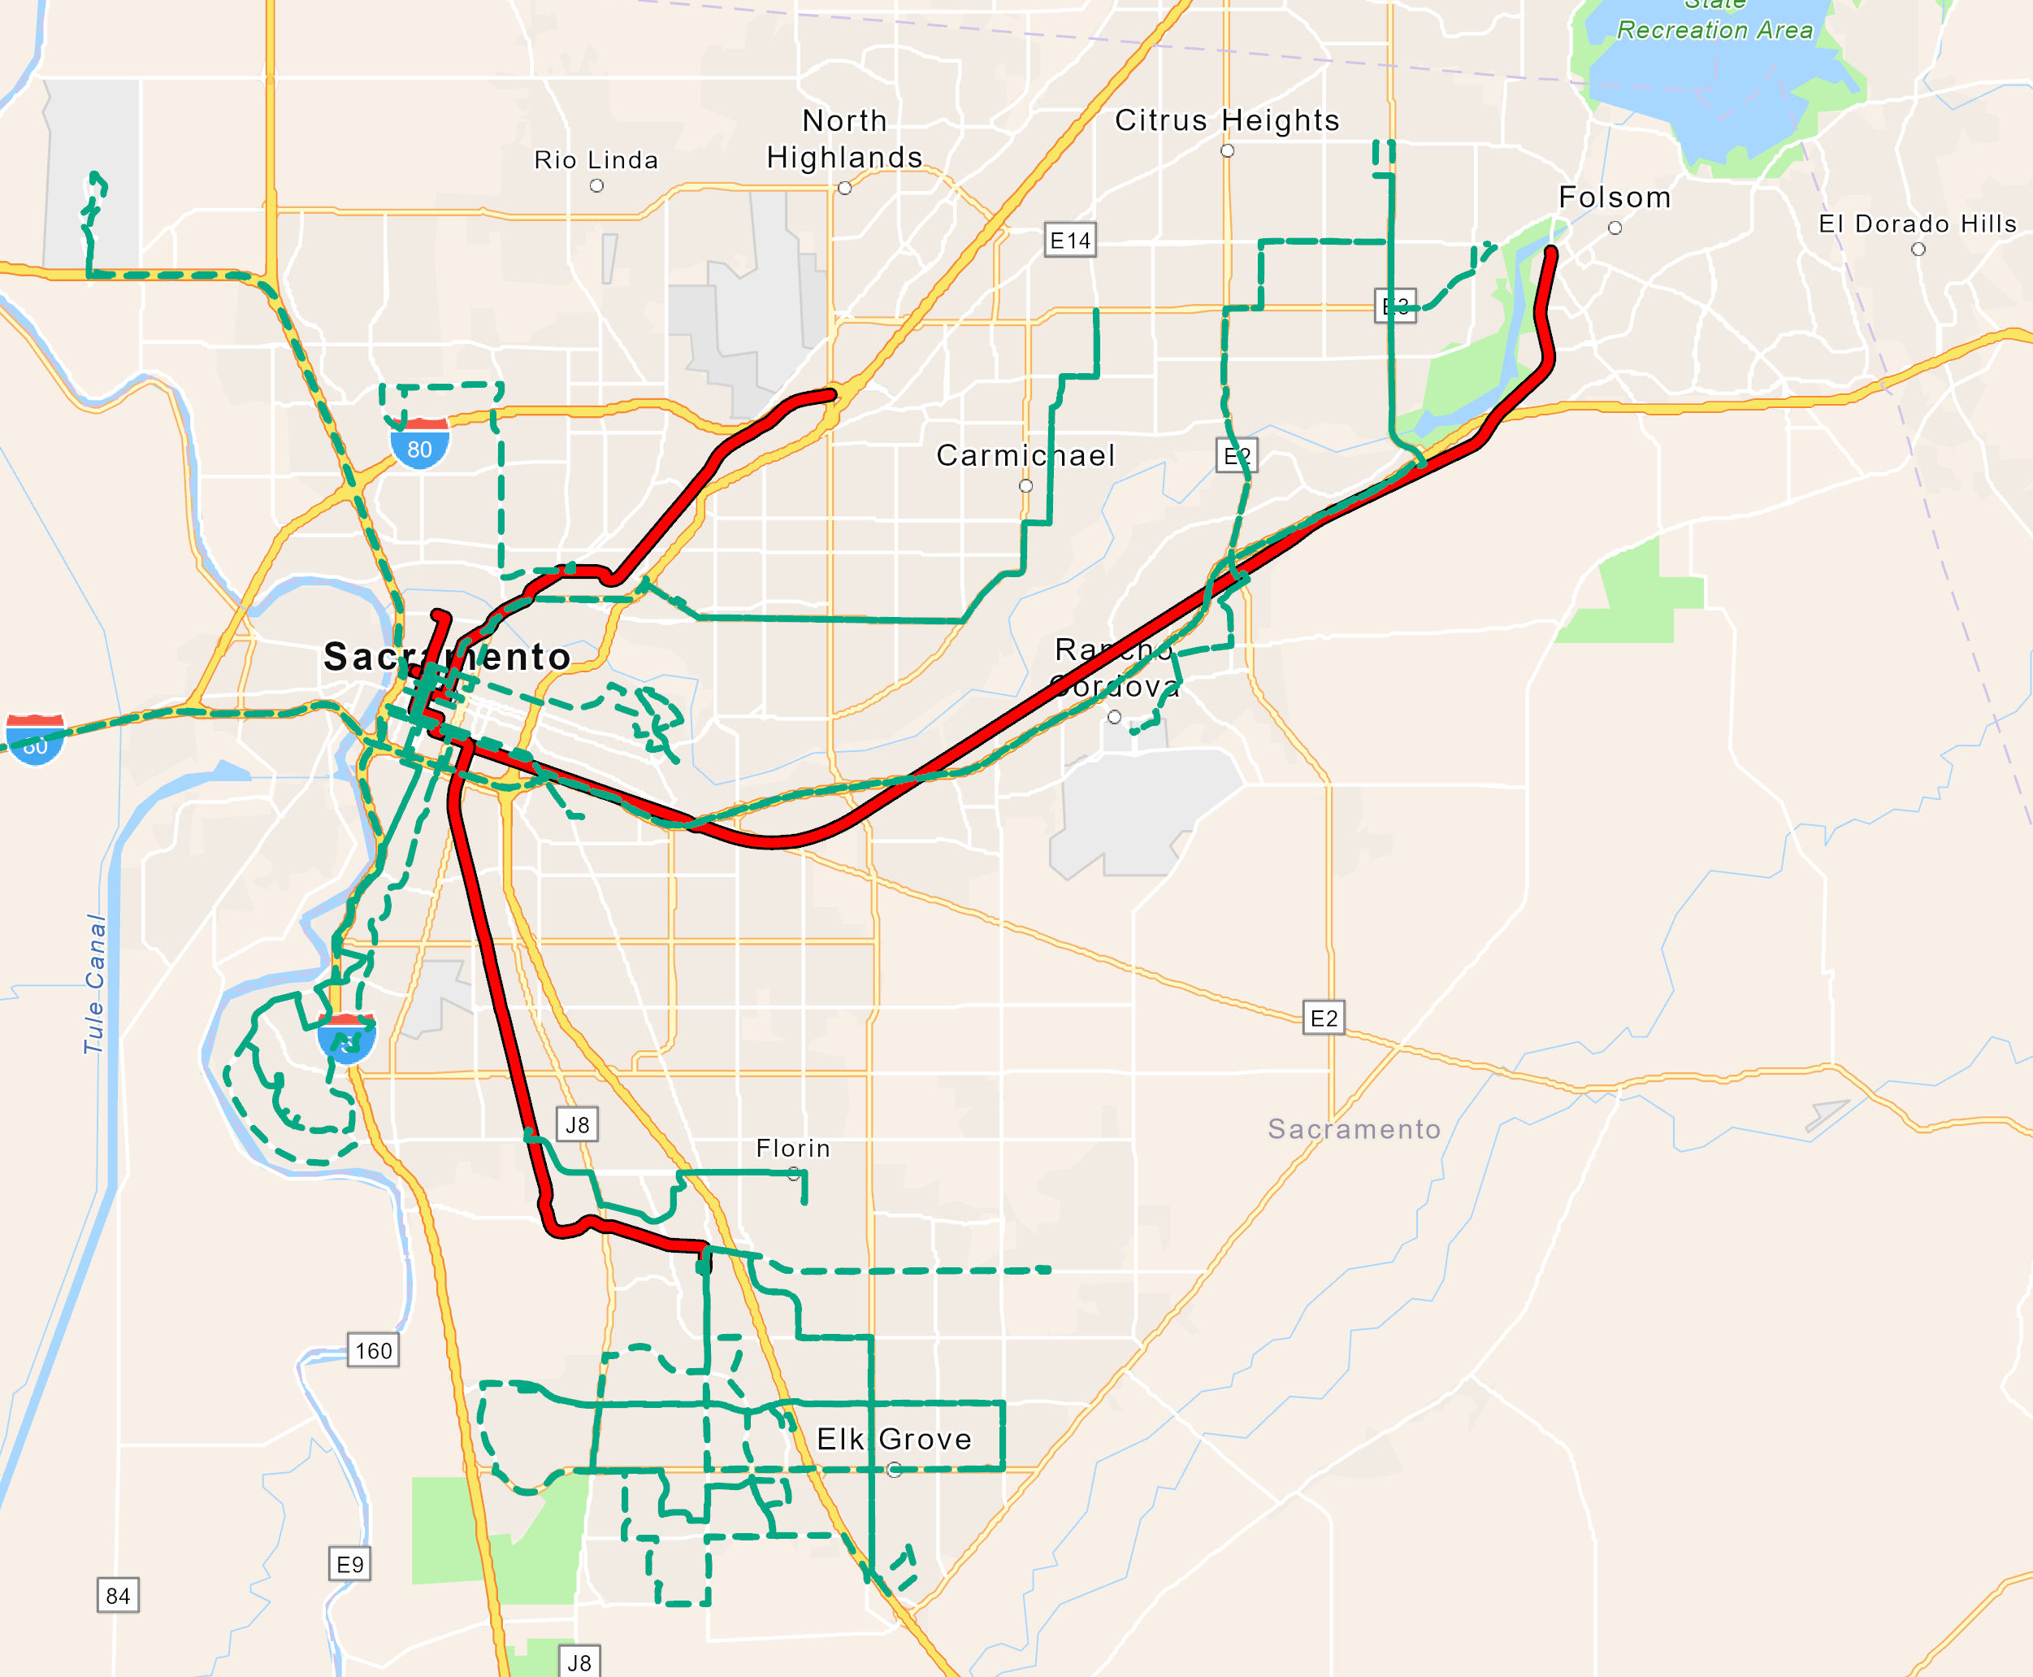
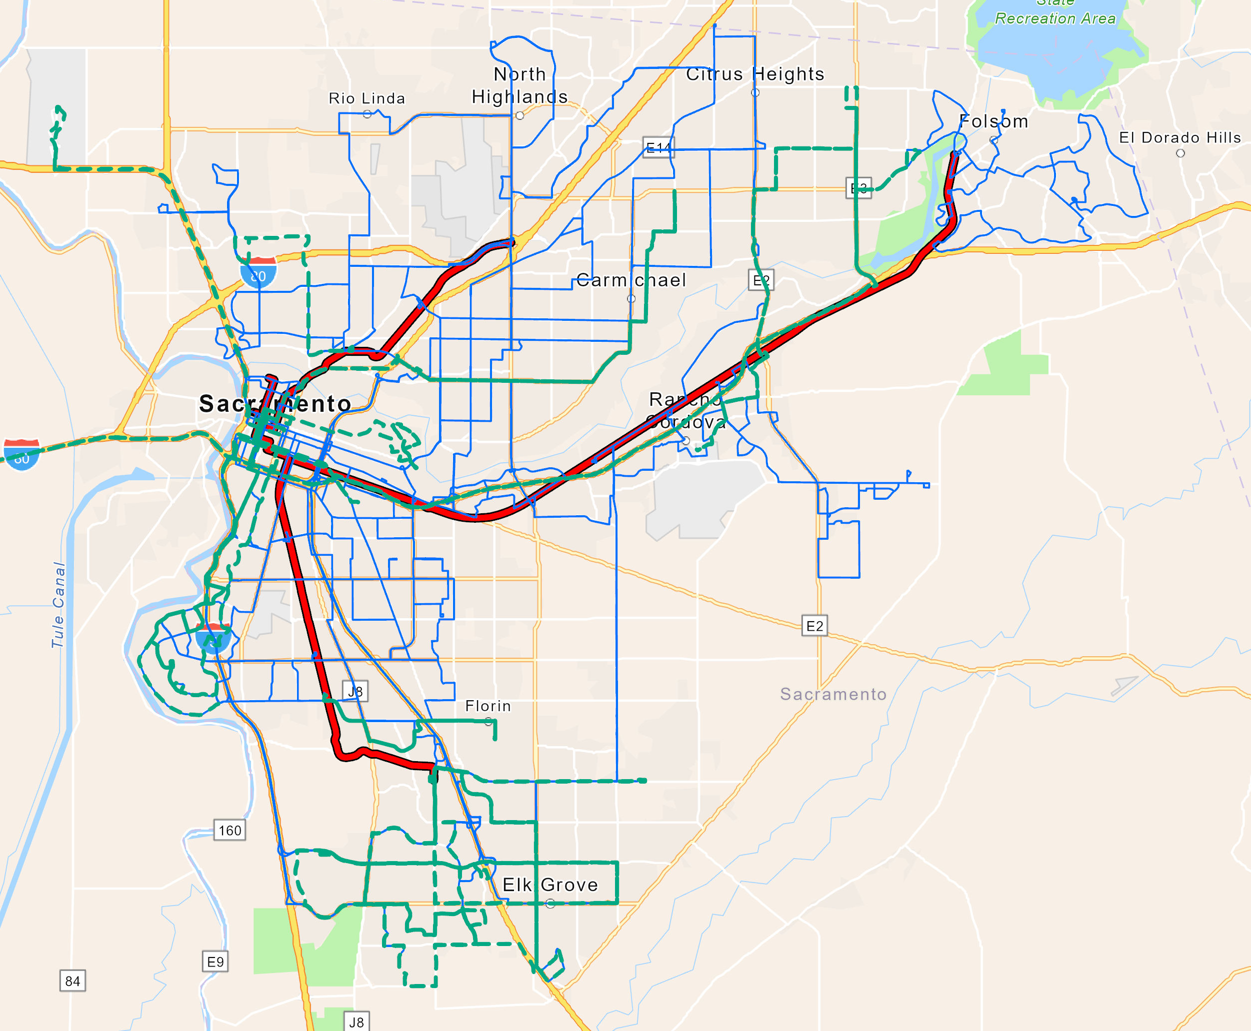
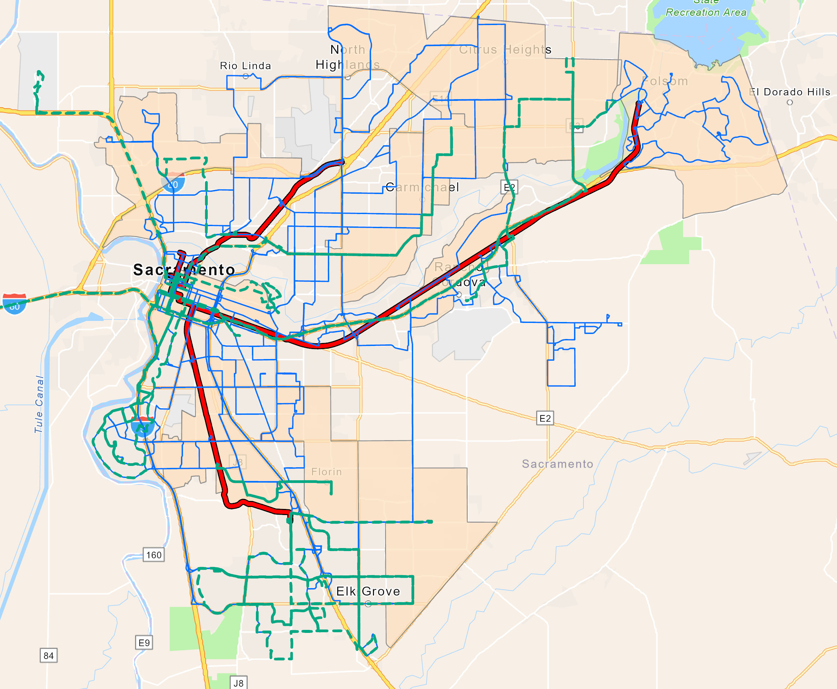
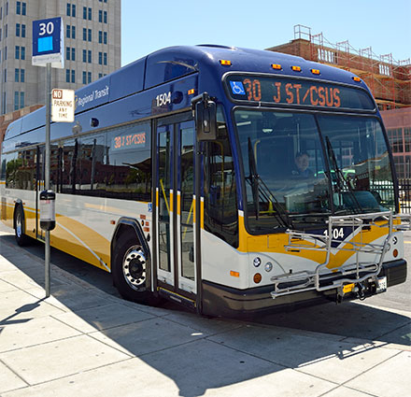
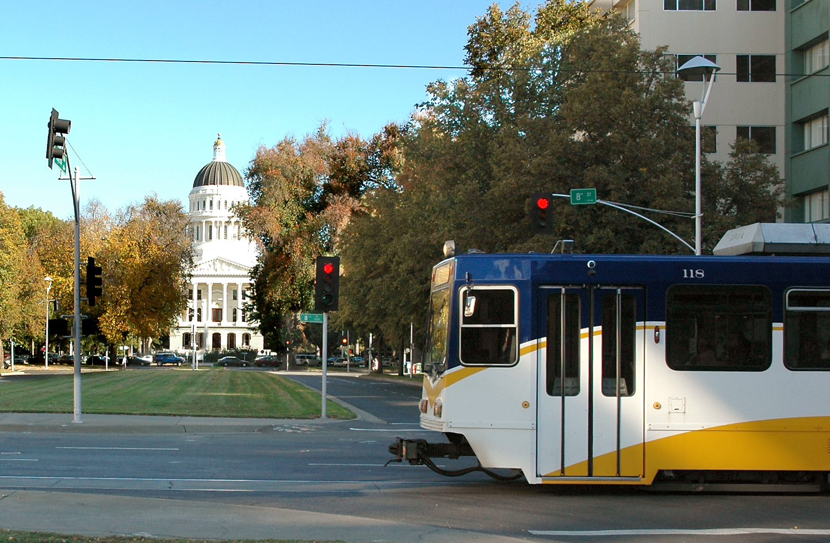
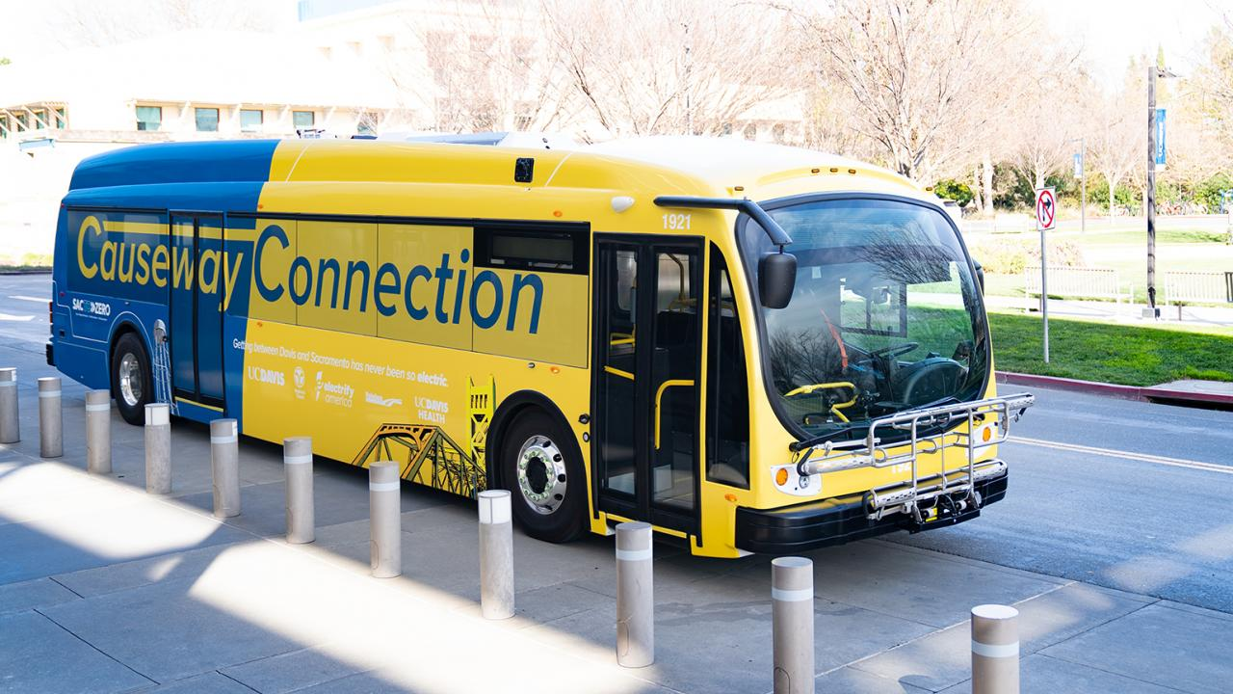
Overview of SacRT Services

Slide 3
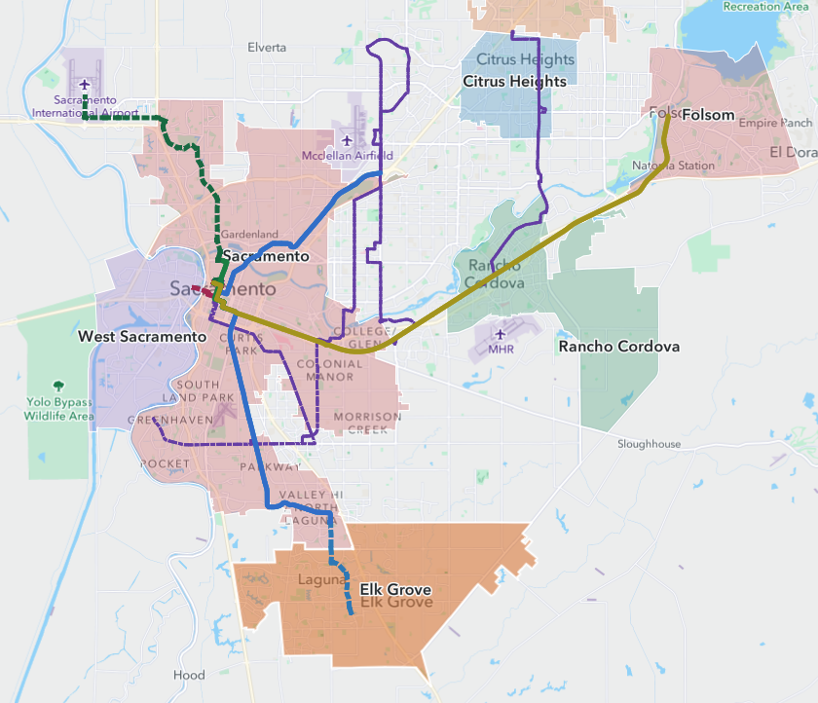
A Snapshot of Major Capital Projects
Over 100 Capital Projects in $2B Budget ($1.1B funded)​:
7
4
8
3
1
2
Light Rail System Modernization
Sacramento Downtown Riverfront Streetcar
Dos Rios Light Rail Station
McClellan Hydrogen Hub
Stockton Blvd & Other BRT Corridors
Blue Line (LRT or BRT) to Elk Grove
Green Line (LRT or BRT) to Natomas/Airport
Horn Light Rail Station
Watt/I-80 Transit Center Improvement
Sacramento Valley Station Relocation Project
9
8
2
3
2
10
5
5
6
6
Notes:
We have over 100 capital projects in our budget right now, with $2B in approved capital projects in FY25, of which approximately $1.1B has been funded.
Over the years since our light rail system was launched many of our light rail state of good repair and other projects were deferred due to the lack of funding. We have worked hard to progress our critical state of good repair projects through strategically pursuing grants despite limited local match.
The capital program includes several categories, such as modernization and expansion of our light rail system; conversion of our bus fleet to zero emission vehicles, bus rapid transit, and facility modernization and expansion.
Our light rail modernization project and other state of good repair projects are our highest priority, as well as our zero-emission transition and capital expansion with both bus rapid transit, light rail projects and streetcar.
This map highlights several of our major capital projects that are moving forward and either have or could be seeking significant capital grant funding in the future.
I’ll cover these briefly

Slide 4


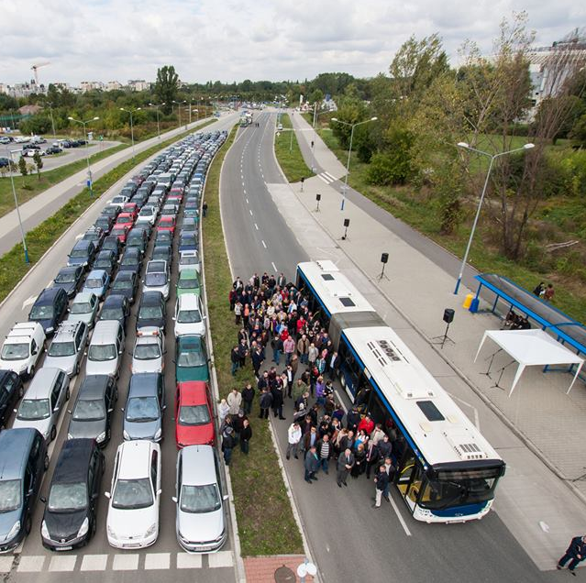

SacRT Rider Profile
Rider Demographic:
67% transit-dependent riders
40% of SacRT trips are work-oriented
20% of SacRT trips are to school
Cost Savings for Riding Transit:
Riding public transportation instead of driving can save more than $13,000 a year
Congestion: Reduce 56 million miles in vehicle miles traveled annually = more time with the family.
Articulated bus carrying up to 200 passengers
Notes:
Here’s a look at our rider profile and impact
68% of our riders are considered transit dependent and do not own a car, with 60% of riders using transit to access either work or school
We served 22M riders in FY19, and we are on a path to return to that level of ridership, with bus service recovered at 103% of prepandemic levels in February 2025
We reduce 56 M miles in VMT annually, reducing congestion and emissions for our region, providing our community with more valuable time for things other than travel, such as family

Slide 5
SacRT’s Measure A History & Impact
SacRT receives ~40% of Measure A on-going revenue or ~$70M/yr to operate public transit
  Approximately 1/4 of SacRT's overall revenue!
SacRT was the first agency to deliver all capital projects from Measure A expenditure plan.
  $62M in capital projects delivered from 2007-2019
    Northeast Corridor Light Rail Enhancements
    Green Line to the Airport Environmental Phase
    Green Line to Township 9 Station
    Extension to Consumnes River College

Slide 6
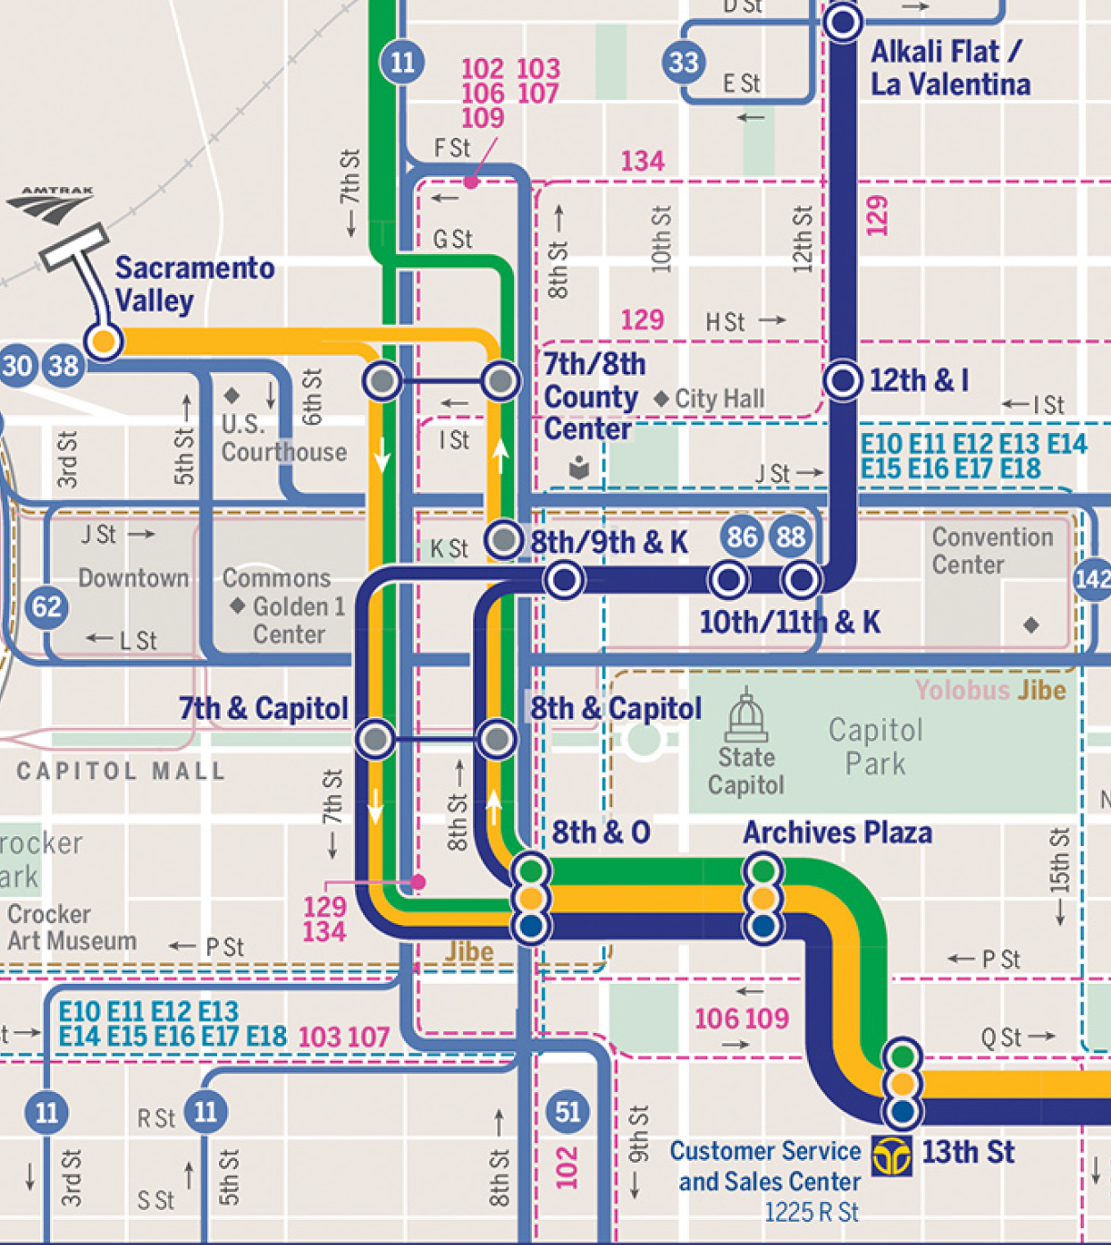
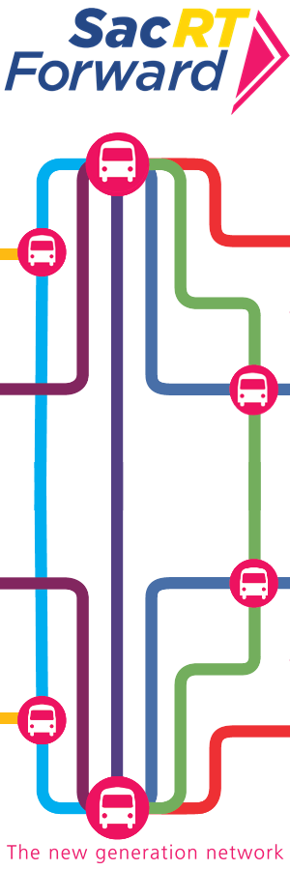
SacRT Forward
Simplified routes and streamlined connections
Decreased headways across most fixed routes from 60 minutes to 30 minutes
Expanded Saturday/Sunday service
APTA Outstanding Transit Agency Award
for SacRT Forward and other initiatives
Measure A funds continue to fund improved service
Notes:
Do we want to put in the total cost of the SRTP service plan here?
You said a couple million for LRTP & Facilities Mgmt Plan, so I just put 2 mil.

Slide 7
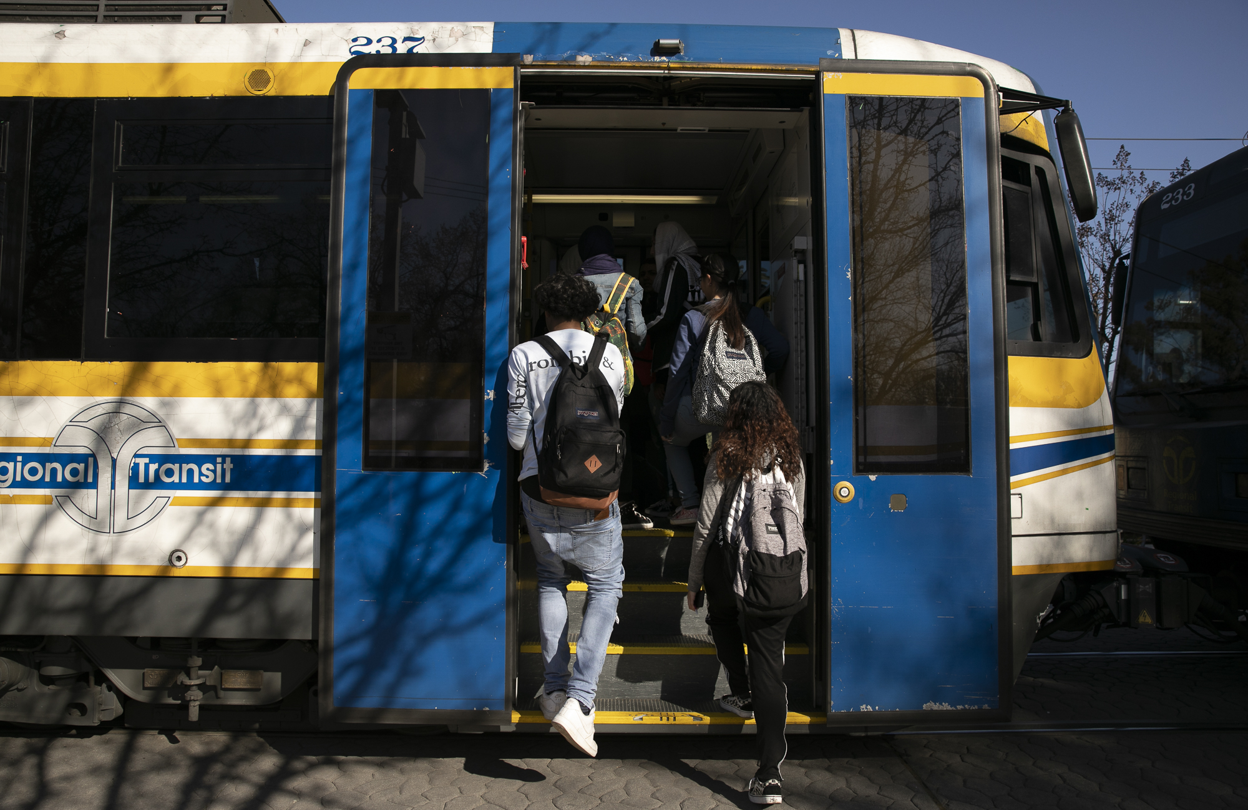
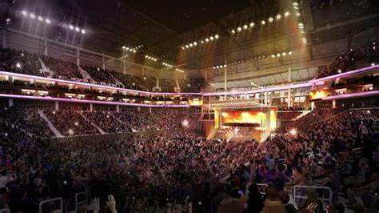
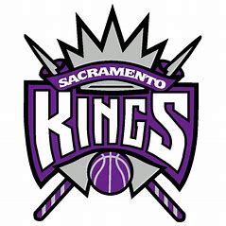
Late Night Folsom Light Rail Service
Original Gold Line Service:
5am to 7pm
Extended Gold Line Service:
5am to 11:30pm
Serves special events and late-night workers!!!
Notes:
Do we want to put in the total cost of the SRTP service plan here?
You said a couple million for LRTP & Facilities Mgmt Plan, so I just put 2 mil.

Slide 8
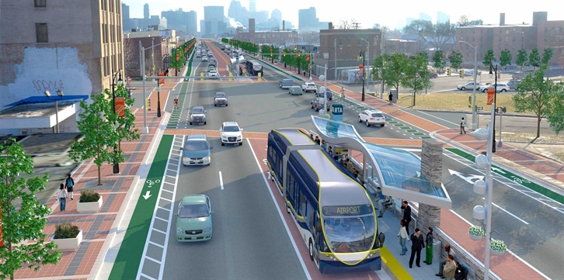
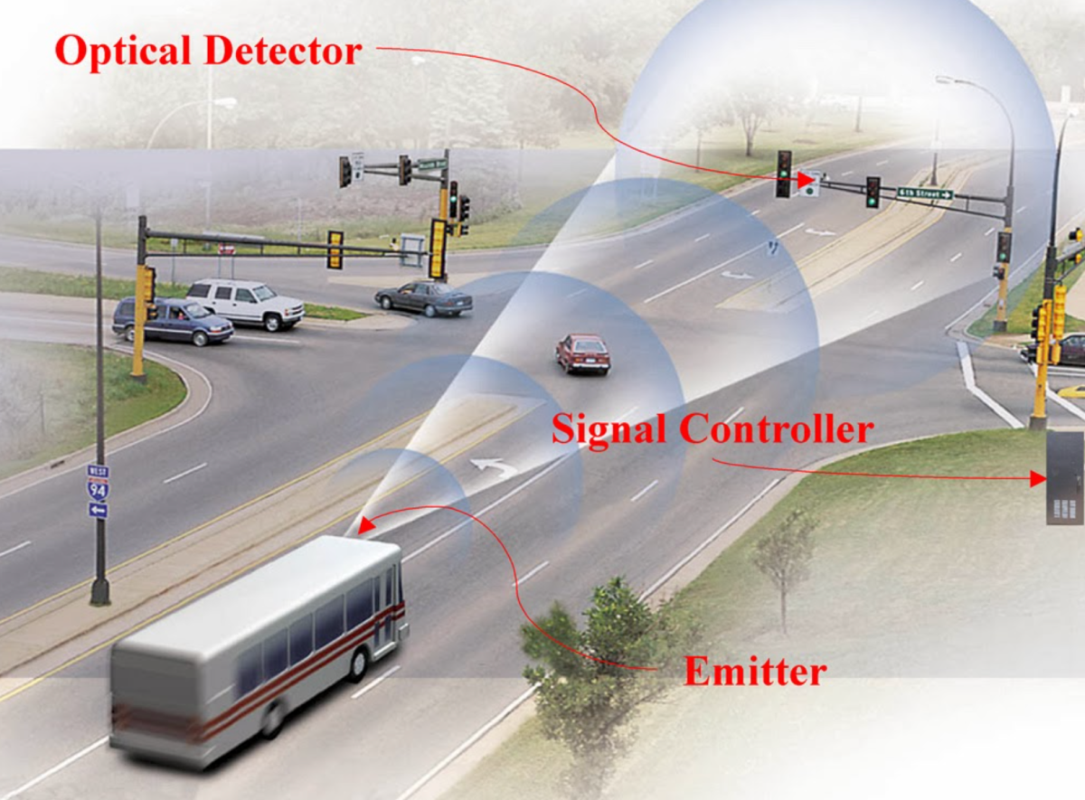
Innovative Bus & Light Rail Service
Measure A funding allows SacRT to explore new service innovations:
Bus Rapid Transit
Transit Signal Priority
High frequency corridors
15 min light rail service to Folsom
2021 High Capacity Bus Service Study
Notes:
Do we want to put in the total cost of the SRTP service plan here?
You said a couple million for LRTP & Facilities Mgmt Plan, so I just put 2 mil.

Slide 9
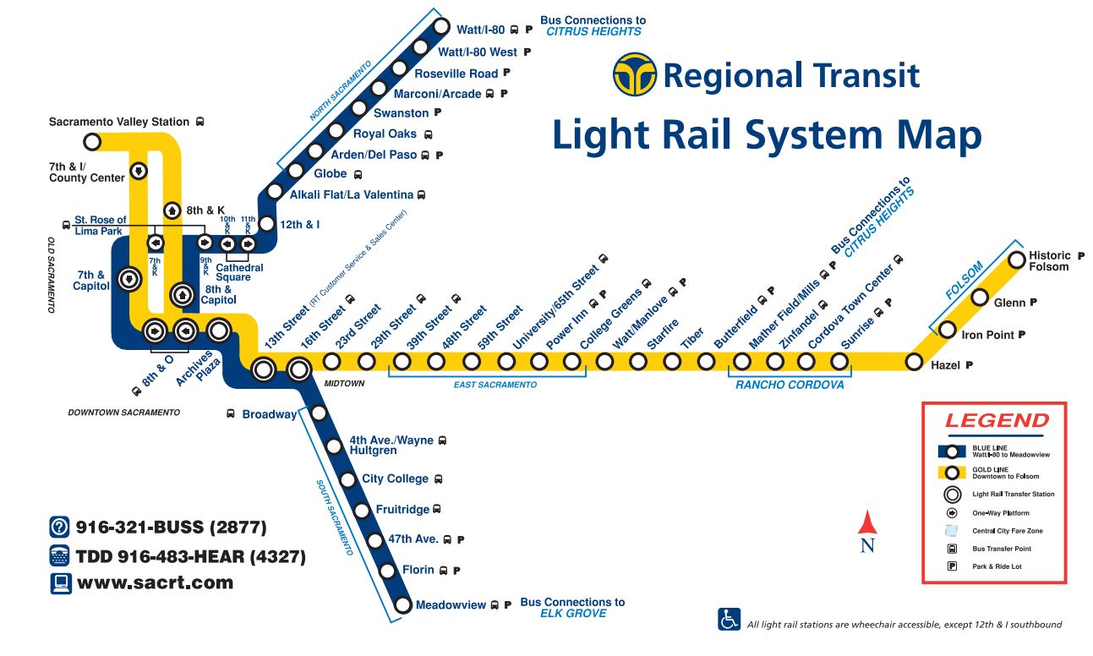
Light Rail Operations Vehicles: 97
Light Rail Track: 44 miles
Stations: 53
Transfer Centers: 30
Park‐and‐Ride Lots: 22
Parking Spaces: 10,113
Average Weekday Passenger Trips: 14,600
Annual Train Car Miles Operated: 3,495,365

Slide 10
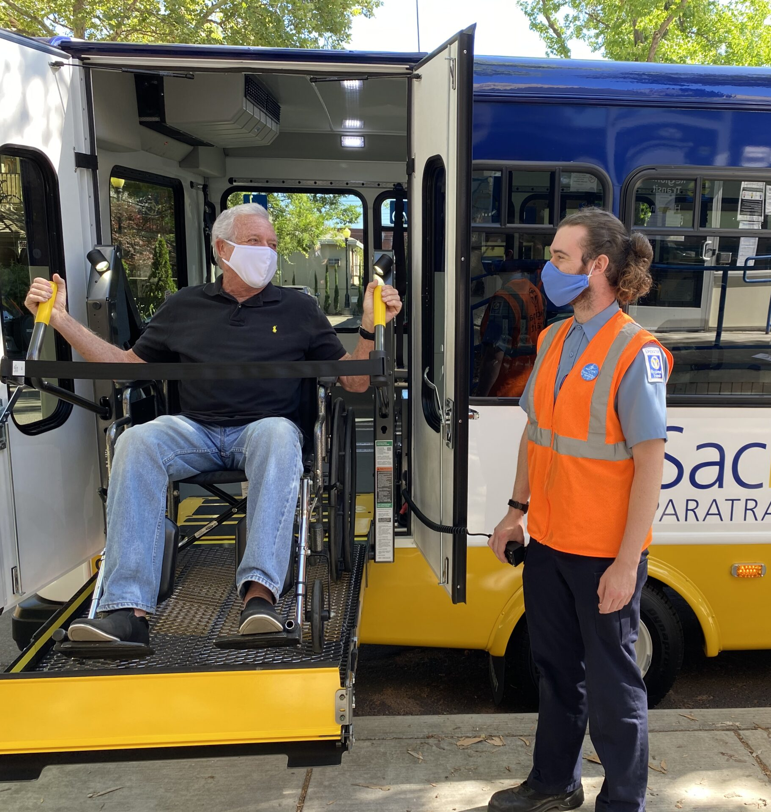
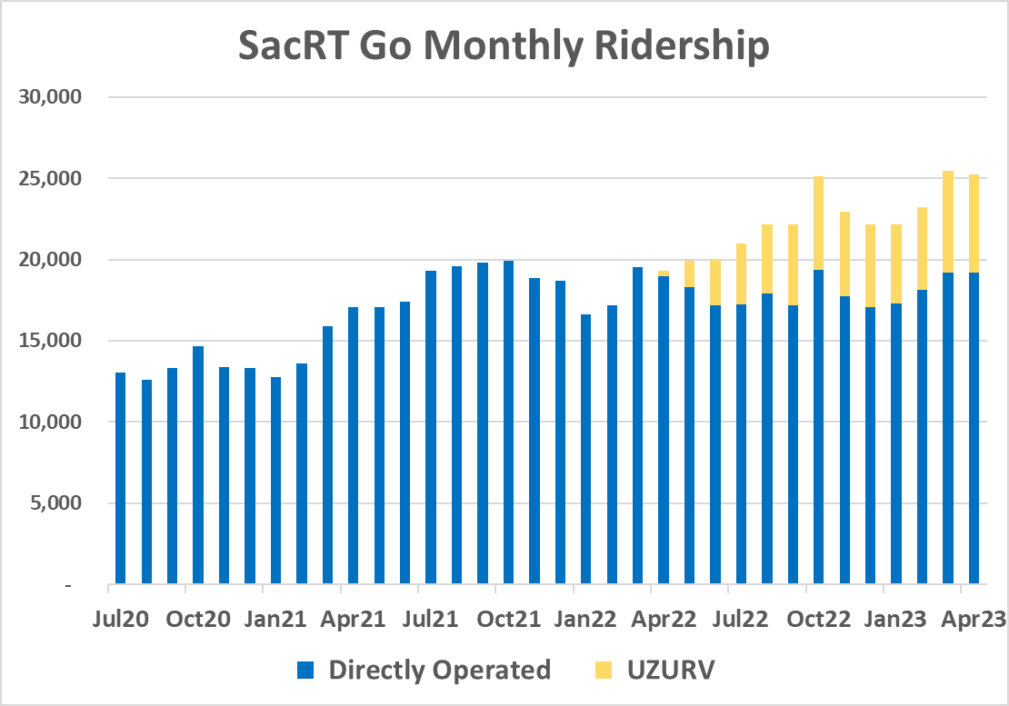
SacRT GO Paratransit
June 2020: SacRT started operating paratransit services directly as SacRT GO
April 2022: UZURV hired to provide supplemental service using private operators
Monthly ridership: doubled post-COVID and since SacRT began directly operating SacRT GO
Notes:
Do we want to put in the total cost of the SRTP service plan here?
You said a couple million for LRTP & Facilities Mgmt Plan, so I just put 2 mil.

Slide 11


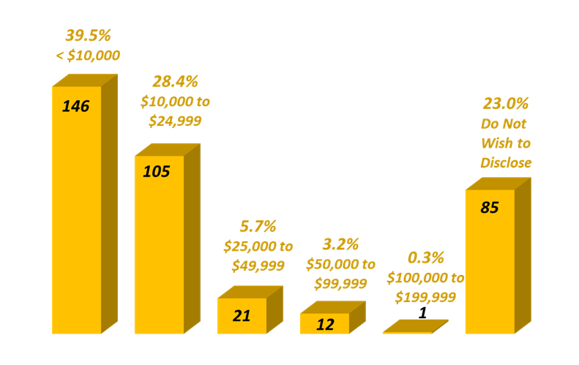
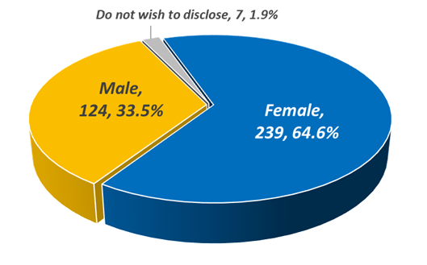

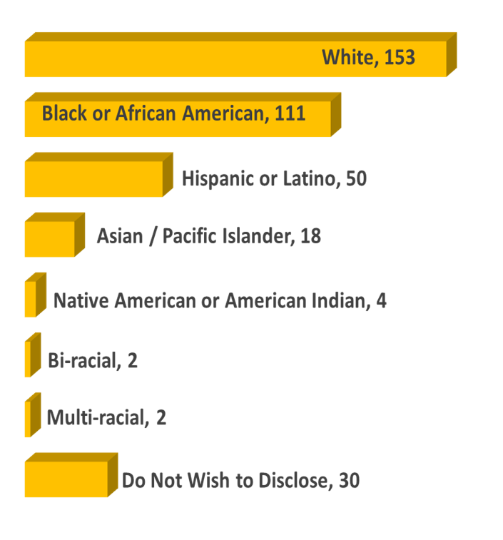

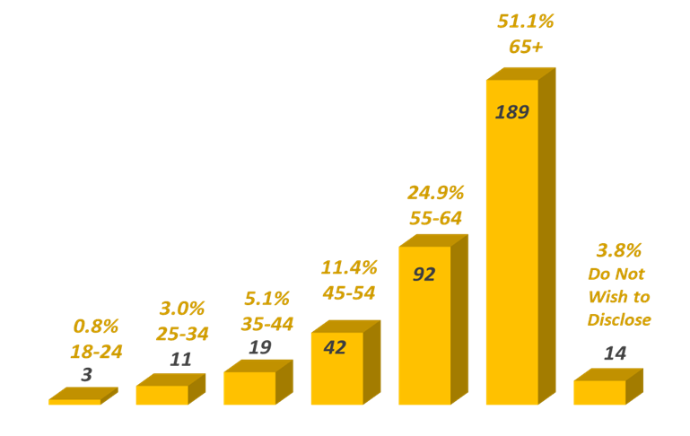
SacRT GO Paratransit
Notes:
Do we want to put in the total cost of the SRTP service plan here?
You said a couple million for LRTP & Facilities Mgmt Plan, so I just put 2 mil.

Slide 12
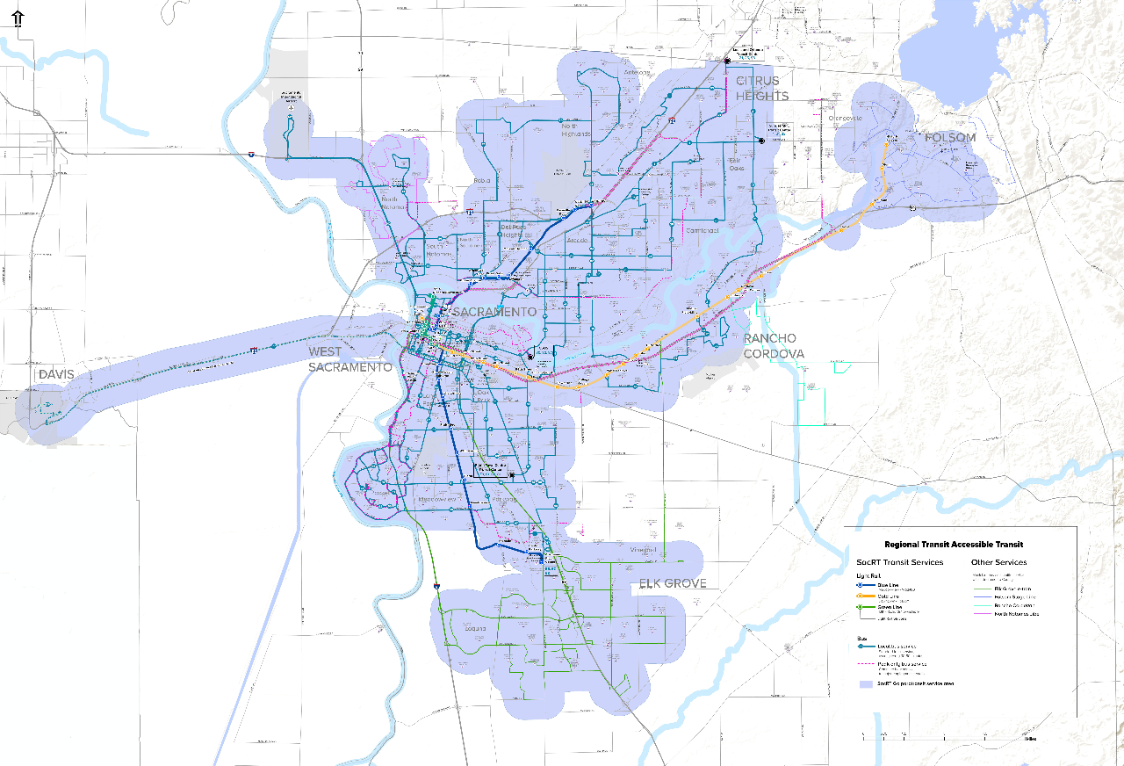
SacRT GO Paratransit
Service Area:
Antelope
Carmichael
Citrus Heights
Davis
Elverta
Elk Grove
Fair Oaks
Folsom
Orangevale
Rancho Cordova
Rio Linda
Sacramento
Notes:
Do we want to put in the total cost of the SRTP service plan here?
You said a couple million for LRTP & Facilities Mgmt Plan, so I just put 2 mil.

Slide 13
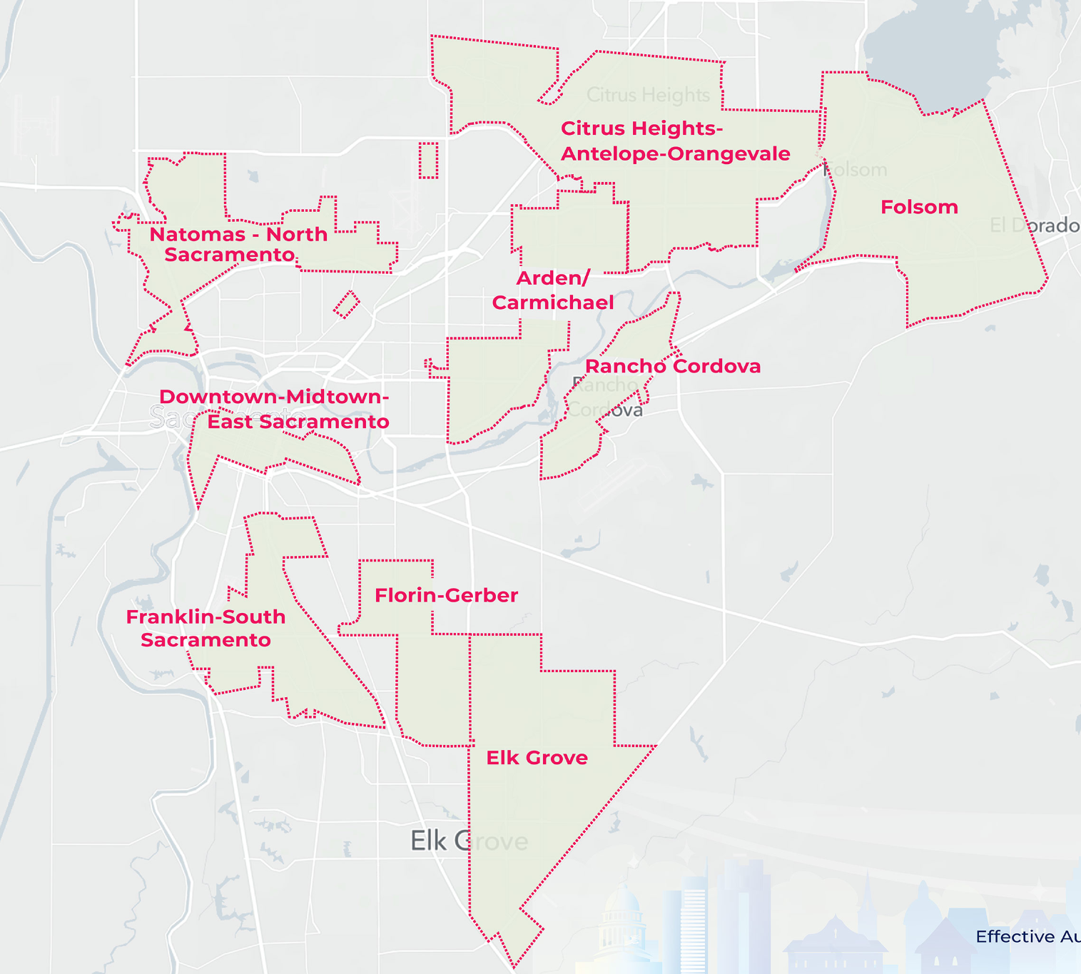
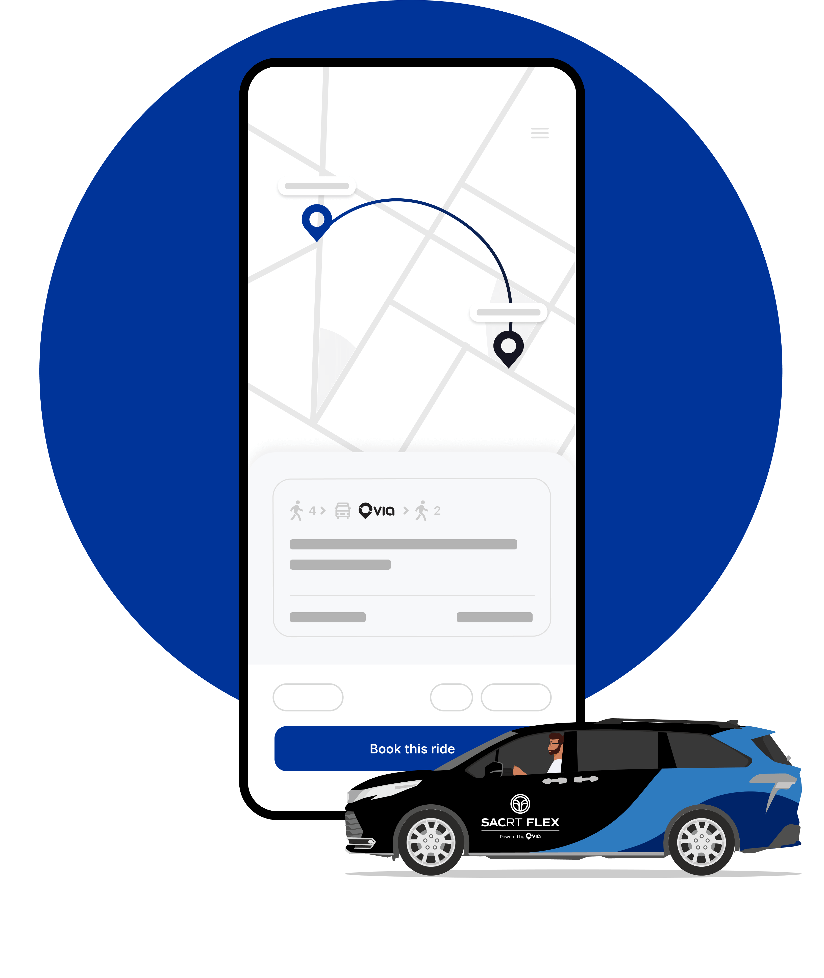
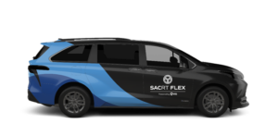
SacRT Flex
9 Zones with focus on DACs and areas with poor transit coverage
Utilizes $800k in annual Community Shuttle funds
Eligible for Seniors, Disabled, and Low-Income
Projected 7,000 monthly riders
Notes:
Do we want to put in the total cost of the SRTP service plan here?
You said a couple million for LRTP & Facilities Mgmt Plan, so I just put 2 mil.

Slide 14
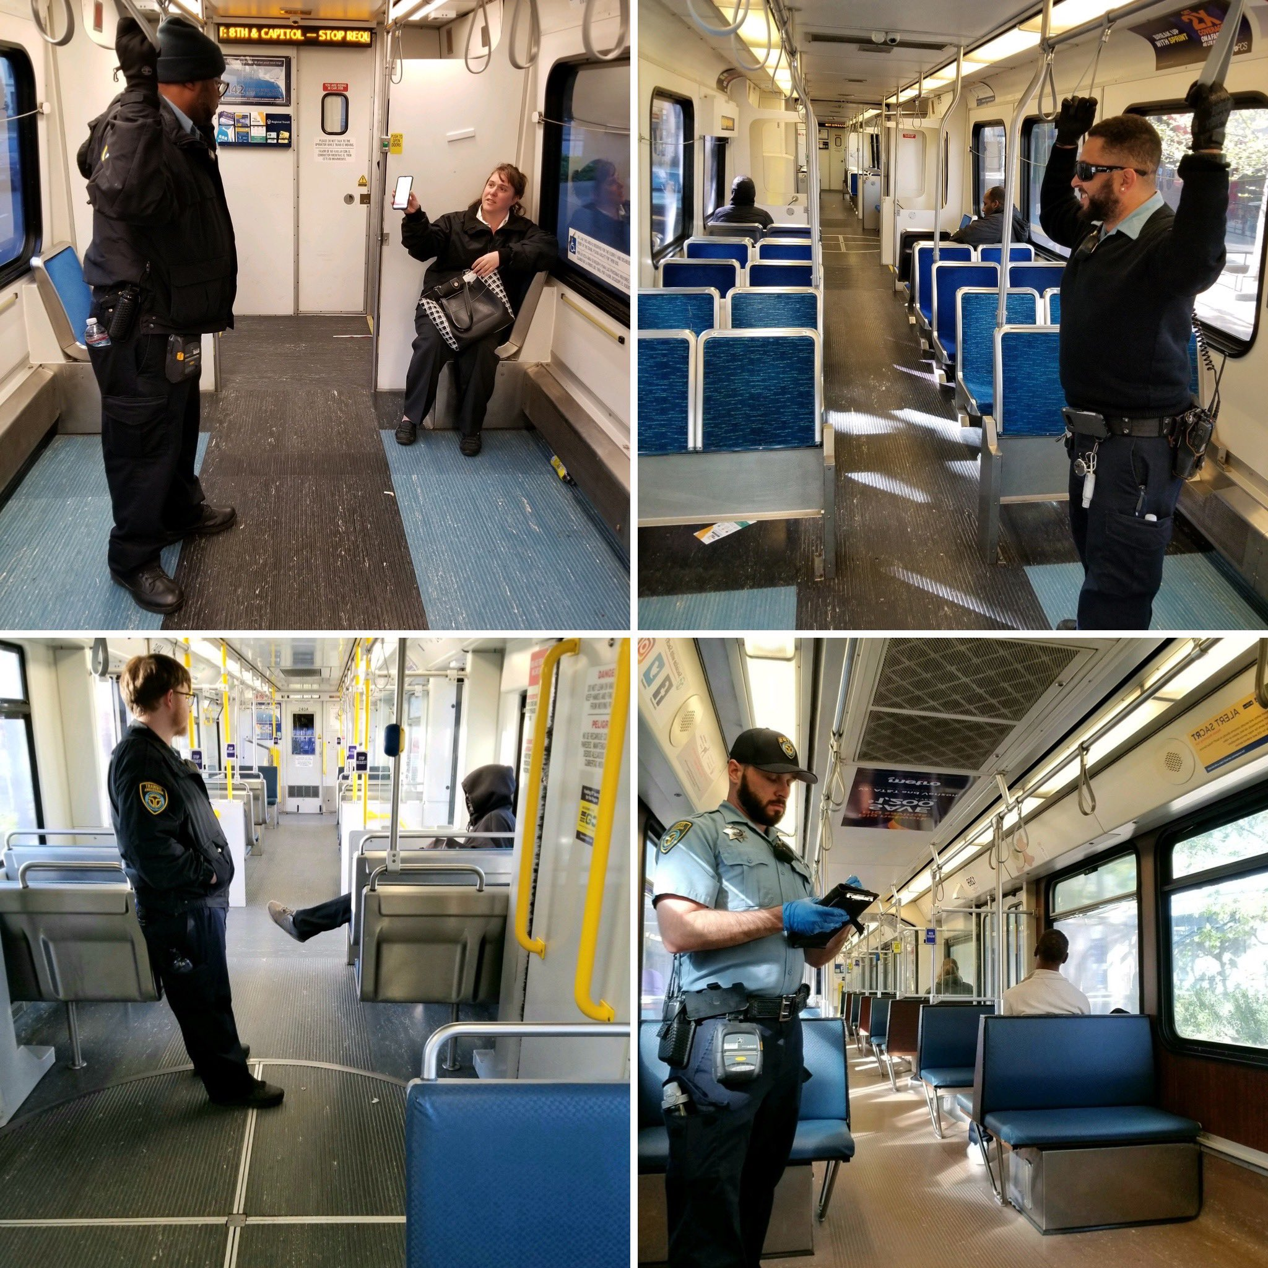
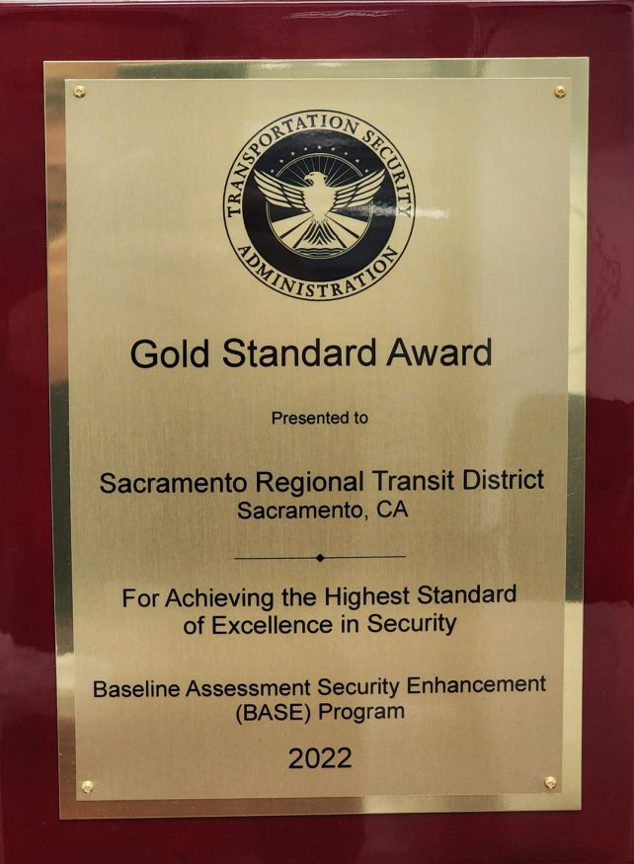
Safety and Security
SacRT has been a recipient of 6 national safety awards in past 7 years
1500 live feed video cameras
32 transit ambassadors
30 transit police
Social services
for the unhoused
Notes:
Do we want to put in the total cost of the SRTP service plan here?
You said a couple million for LRTP & Facilities Mgmt Plan, so I just put 2 mil.

Slide 15

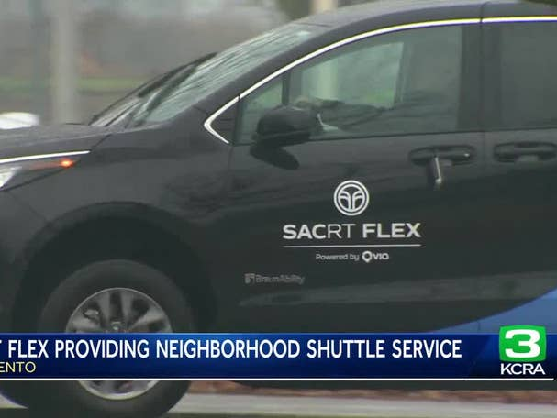
SacRT 5 - Year Strategic Program FY 24-28
SacRT Forward – continue to implement goals and strategies identified in our redesigned bus network
Late Night Rail Service to City of Folsom - continue to provide late night light rail service to the City of Folsom.
Innovative Bus & Light Rail Service - Provide innovative public transit projects, including BRT and 15-minute LRV service to Folsom, to increase access to public transit for essential travel, especially to DACs.
Light Rail Service – Continue to provide light rail service to Sacramento County
SacRT GO Paratransit - Increasing service reliability to improve customer satisfaction and better provide SacRT GO paratransit bus service to get people where they want to go, when they want to go.
SacRT Flex – Continue to operate Flex microtransit to provide on-demand neighborhood shuttles to DACs and areas with little to no transit service.
Safety and Security – Continue Gold standard safety program.

Slide 16
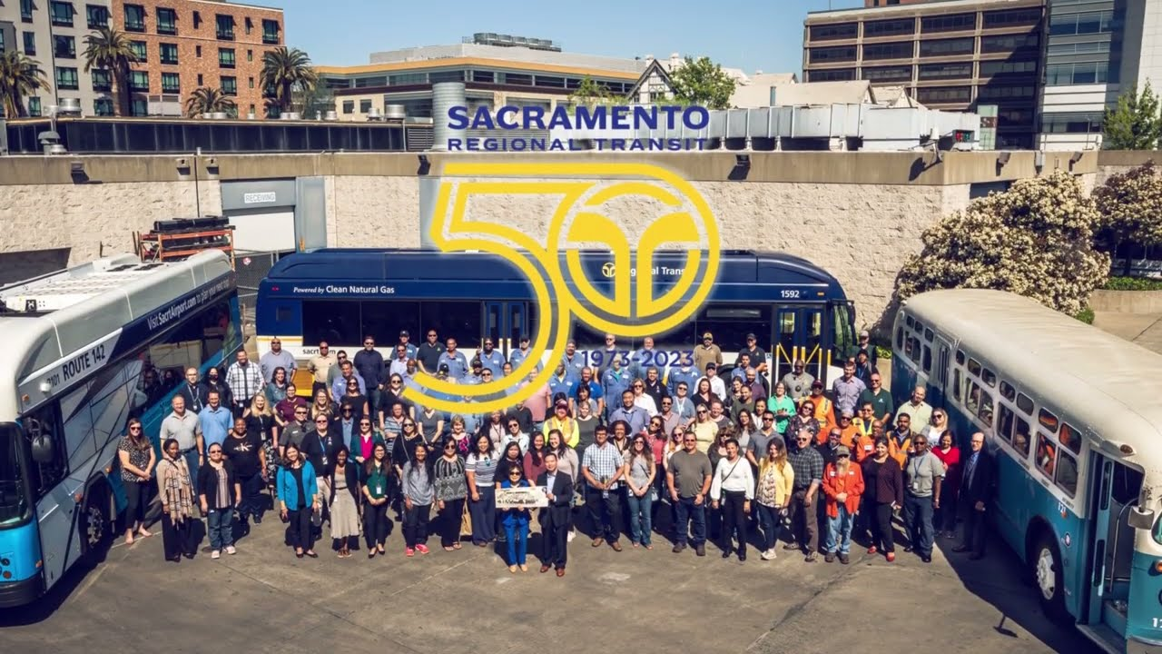
Questions & Comments
Anthony Adams
Director of Planning & Grants
Sacramento Regional Transit District
aadams@sacrt.com

