Slide 1
The Sacramento Transportation Authority
Potential Support for the I-Street Bridge Project
Interim Financing Options & Cost Sharing Considerations
Presented by PFM Financial Advisors LLC
February 20, 2026
PFM Financial Advisors LLC
www.pfm.com
44 Montgomery Street
3rd Floor
San Francisco, CA 94104

Slide 2
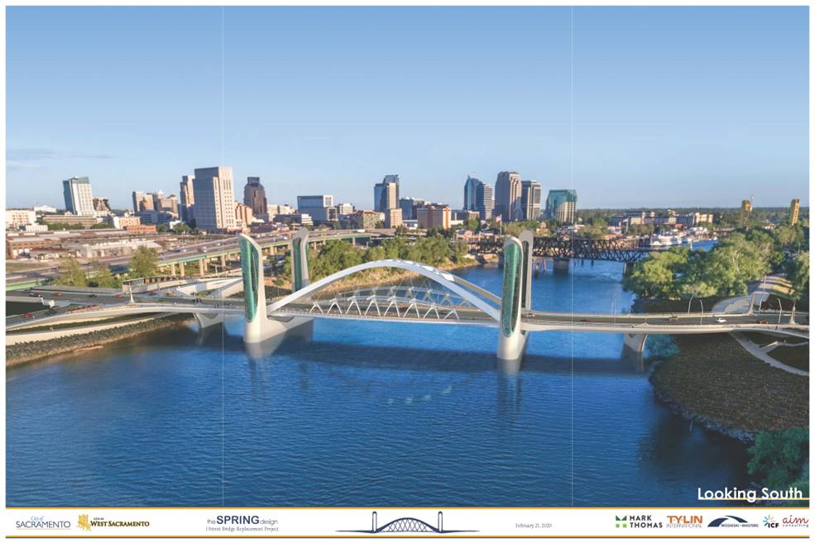
Project Overview
$300 million dollar lift bridge project spanning the Sacramento River near the Railyards District (City of Sacramento) and the Washington District (City of West Sacramento), enhancing multimodal connectivity.
Notes:
Dustin’s intro

Slide 3
Opportunities
Leverage Measure A’s financial strength to ensure timely delivery of a transformative regional infrastructure project.
Unlock over $250 million in committed federal and state grant funding that otherwise would be delayed due to reimbursement limits.
Protect other jurisdictions Measure A shares —risk and repayment are isolated to the City of Sacramento’s share.
Secure current pricing for a project that has seen costs rise annually.
Enable related regional projects, including the I Street Bridge Deck Conversion and access improvements to the Sacramento Valley Station.

Slide 4
STA Engagement
2023
STA began discussions about the I Street Bridge project funding gap with banks
Early 2024
STA and PFM develop strategies to address the City’s cash flow challenges related to grant reimbursements
2024
STA and City of Sacramento Staff began discussions about the I Street Bridge project funding gap
2025-2026
STA,PFM, and the City of Sacramento developed a financing plan and overarching master agreement

Slide 5
August Plan Vs Current Plan
 | Current | August
HBP Grant Reimbursement Cap | $40M per year | $20M per year
LOC Need | Up to $95M | Up to $165M
Payback Term | ~5 years | ~12 years
Estimated Interest & Fees | $7.0-$11.2M | $28.2-$41.3M

Slide 6
Project Overview & The Potential Use of the Line of Credit (LOC)
The I-Street Bridge Project (the “Project”) is a fully funded project, but the delayed timing of grant reimbursement creates the need for “interim financing”
  A bank line of credit (LOC) may be utilized to cover interim funding shortfalls
While future grant receipts are expected to repay any draws on a LOC, those grant receipts would not likely be the security or pledge for the lender.
  STA’s Measure A sales tax revenues could provide credit support as the security
Even though Measure A revenues would provide credit support to lower the cost of borrowing on the LOC, STA would look to the City of Sacramento to demonstrate their ability to pay all interest and fees and repay principal draws on the LOC in the event there was a disruption to grant receipts
  The City of Sacramento would, in turn, look to the City of West Sacramento to share the responsibility to pay interest and fees, and principal repayment of the LOC, should the need arise

Slide 7
Funding Need
Project expenditures are currently expected to exceed available funding by fiscal year 2026
Peak cumulative shortall of $95 million occurs in FY 2029
Currently estimated cashflows assume slower arrival of grant funding, paying off total liability by FY 2032

Slide 8
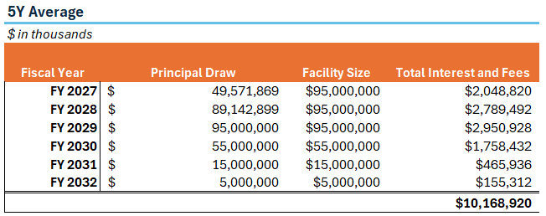
Interest Costs
Given the mismatch in funding need and grant reimbursement, a line of credit (LOC) may be used as interim financing
The LOC would be established to meet the peak shortfall ($95M), with an additional cushion to meet any potential cashflow fluctuations
Once established, max LOC facility size could be reduced as grant funds flow in
Assumptions
First draw in 7/1/2026
Interest rate on LOC draws estimated at 3.42% based on 80% SOFR as of February 10, 2026
The 5-year average of SOFR currently sits at 3.11%, slightly lower than current rates
Other assumed costs include unutilized balance fees (35 bps) and one-time origination and renewal fees ($400k total assumed)

Slide 9
Conclusion
The use of a LOC allows STA flexibility in its approach to the I-Street Bridge project financing, as it allows for repayment as grant funds flow in without the long-term encumbrance of bonded debt
Interest costs remain manageable, with the potential for short-term rates to lower in 2026

Slide 10
Thank You

Slide 11
Disclosures
ABOUT PFM
PFM is the marketing name for a group of affiliated companies providing a range of services. All services are provided through separate agreements with each company. This material is for general information purposes only and is not intended to provide specific advice or a specific recommendation.
Financial advisory services are provided by PFM Financial Advisors LLC, a registered municipal advisor with the Securities and Exchange Commission (SEC) and the Municipal Securities Rulemaking Board (MSRB) under the Dodd-Frank Act of 2010. Swap advisory services are provided by PFM Swap Advisors LLC which is registered as a municipal advisor with both the MSRB and SEC under the Dodd-Frank Act of 2010, and as a commodity trading advisor with the Commodity Futures Trading Commission. Additional applicable regulatory information is available upon request.
Consulting services are provided through PFM Group Consulting LLC. PFM Solutions LLC provides a financial modeling platform for strategic forecasting. A web-based platform for municipal bond information is provided through Munite LLC.
All services are provided through separate agreements with each company.
For more information regarding PFM’s services or entities, please visit www.pfm.com.

