Slide 1
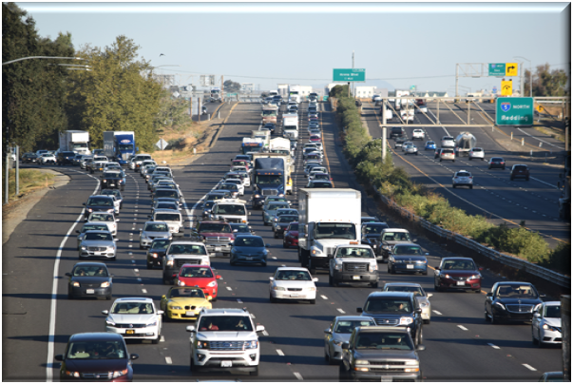
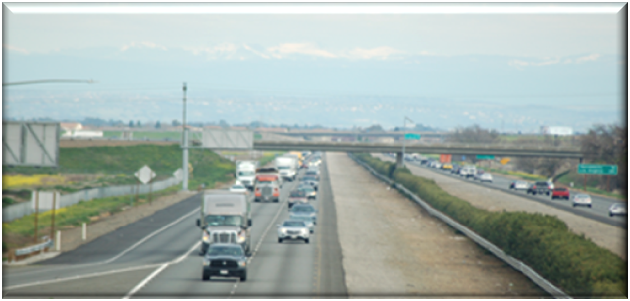
I-5 Managed Lanes Projects
July 2024
Caltrans District 3

Slide 2
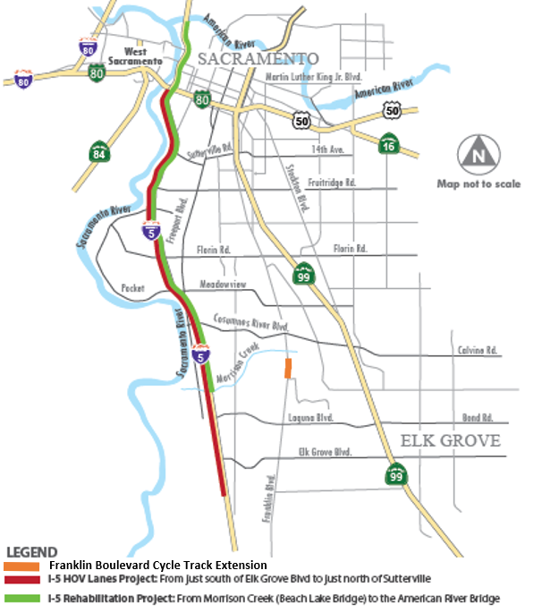
I-5 CEP PROJECT LIMITS AND SCOPE
Added 23 miles of new managed lanes
Constructed 40-year service life pavements on mainline and all ramps/connectors.
Modified 7 ramps w/ ramp meters and transit/carpool queue jump preferential lanes
Constructed auxiliary/transition lanes between Pocket Road and Florin Road.
Installed ITS Elements and fiber optic line
Replaced or upgraded drainage systems, overhead signs, lighting, pumping plants, approach slabs, guard rail, and safety barriers.

Slide 3
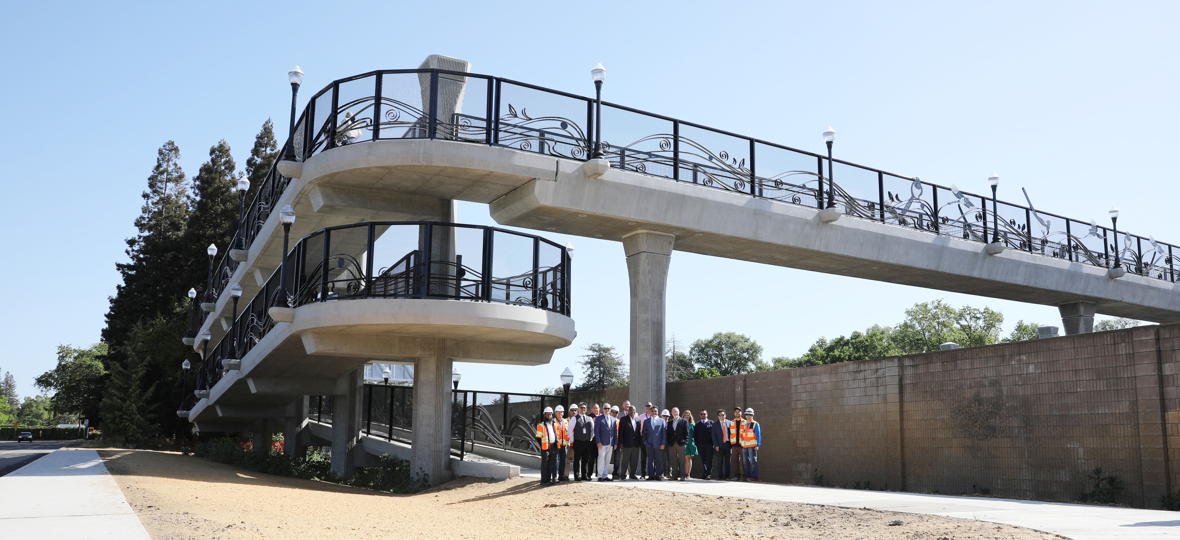
I-5 CEP PROJECT LIMITS AND SCOPE
New Casilada Way Pedestrian Over-Crossing
Cycle Track along Franklin Blvd. implemented by the City of Elk Grove connects to the RT Blue Line at Consumnes River College Station.
Upgraded pedestrian ramps and sidewalks to current ADA standards at major interchanges.

Slide 4
I-5 CEP PROJECT FUNDING AND SCHEDULE
FUNDING
SHOPP | $313.5 million
SB 1 - SCCP | $14.8 million
STA Measure A | $33.2 million
SACOG (CMAQ) | $8.5 million
TOTAL COST | $370 million
Highlight measure A statement
Project Milestones
Contract Awarded | May 1, 2019
Begin Construction | May 31, 2019
Complete Construction | October 24, 2023

Slide 5
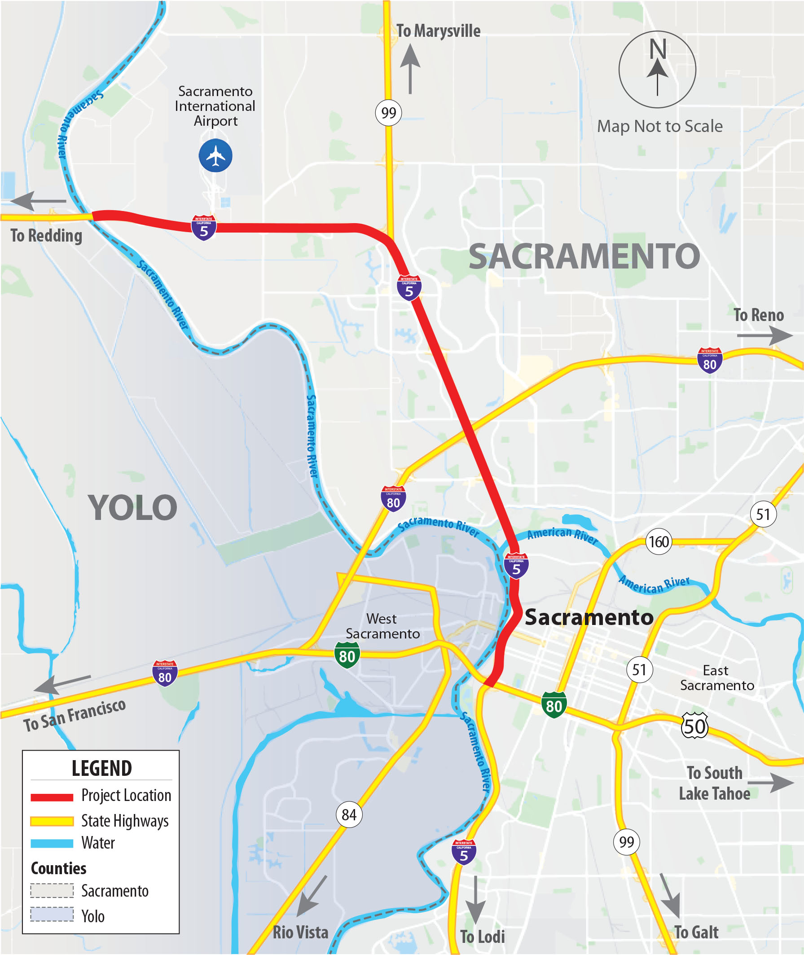
^{I-5 ML PROJECT LIMITS}

Slide 6
^{Need and Purpose}
Need (Existing )
Purpose (Goals)
Recurring Morning, Evening, & Weekend Congestion
Ease Congestion & Improve Person Throughput, eliminating cut through traffic through disadvantage communities
Inefficient Operation of Freight and Transit
Support & Improve Reliable Transit and Freight
Single Occupancy with limited Multi-modal Options
Reduce GHG by Improving Corridor Operations
Lack of Traveler Information and Monitoring
Provide Expedited Travel Time Information

Slide 7
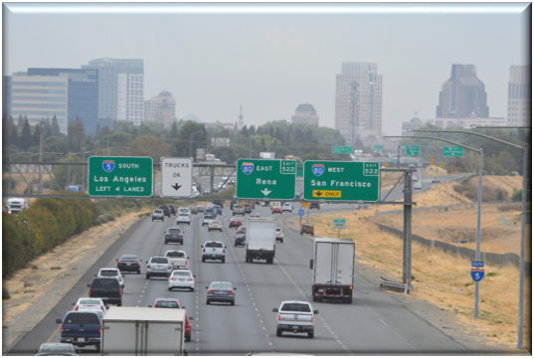
^{I-5 ML PROJECT SCOPE}
Add Managed Lanes
Pave median, modify bridges and install median barrier
Add Integrated Corridor Management (ICM) Elements
Corridor Adaptive Ramp Metering
CCTV/CMS
Transit Priority for onramps
Rehabilitate/modify drainage system

Slide 8
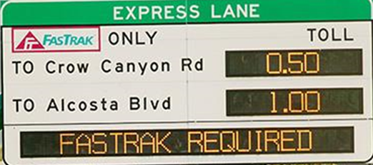
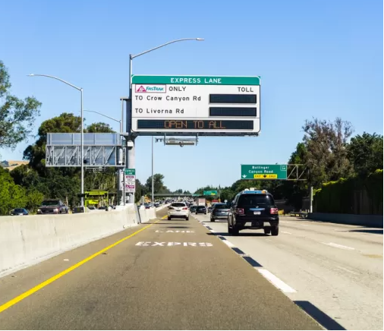
^{Sac-5 ML Project Alternatives}
1 | No Build
2 | Build- 1 HOV 2+ Lane in Each Direction
3 | Build- 1 HOT 2+ Lane in Each Direction
4 | Build- 1 HOT 3+ Lane in Each Direction (HOV 2 may pay reduced toll or full toll)
5 | Build- 1 Express Lane in Each Direction (Everyone Pays)
6 | Build- 1 Transit Lane in Each Direction
7 | Convert current #1 mixed-flow lane to HOV 2+
8 | Build- 1, Convert 1 GP HOT 2+ Lanes in Each Direction
9 | Build- 1, Convert 1 GP HOT 3+ Lanes in Each Direction (HOV 2 may pay reduced toll of full toll)

Slide 9
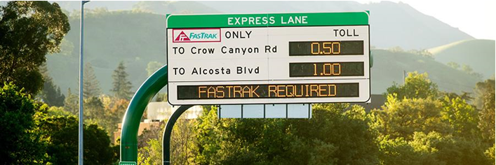
^{Project Benefits}
Reliable connectivity to jobs, Sacramento International Airport and activity centers such as Golden 1 Center
A more reliable highway system for goods movement with an increase of > 1200 additional trucks per day
Promote ride sharing and mode shift to transit
Improve safety by reducing number of congested related collisions
Provides reliable transit and promotes connectivity to Disadvantage Communities
Improve travel times for managed lanes users and transit by over 40%
Improve travel times for general purpose lane users and freight by almost 30%

Slide 10
^{PROJECT FUNDING STATUS}
Total Project Cost: $452.6 million
Available funding: $ 69.3 million
SACOG $11.8 million – Environmental Phase
STA Measure A $57.5 million - Design, RW and Construction
Potential TCEP Funding SB1 Cycle 4: $ 15.5 million
$10.5 million - Design
$5 million – RW (Support & Capital)
Unfunded Need: $367.8 million
Includes $50 million for VMT Mitigation

Slide 11
^{PROJECT SCHEDULE}
Project Milestones
Environmental Approval | Summer 2025
Final Design | Spring 2027
Begin Construction | Fall 2027
Complete Construction | Summer 2030

